Slide 2
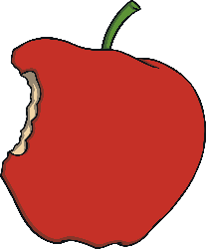
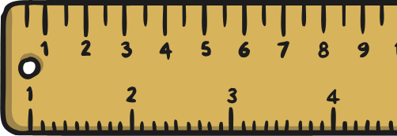
Questions, Questions!
Click on a question to take you to that page.
What were the classrooms
like in the past?
How were children
punished in the past?
What equipment was
used in the past?
What was the teaching and learning like in the past?

Slide 3
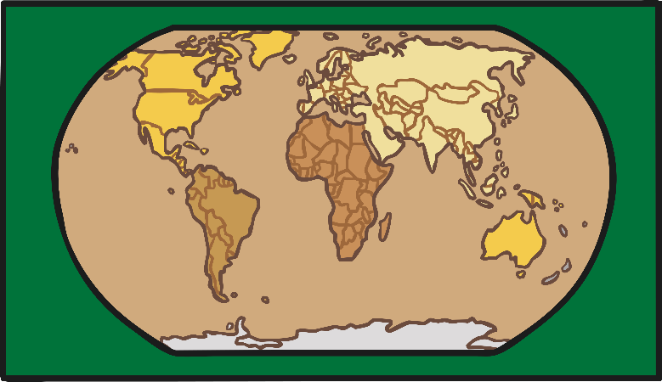
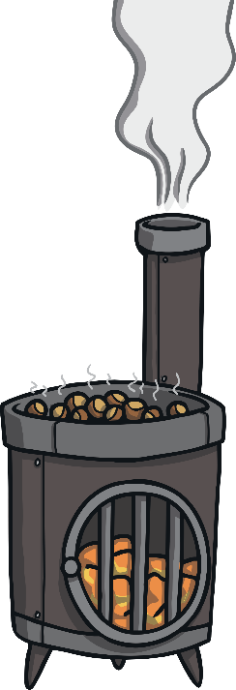
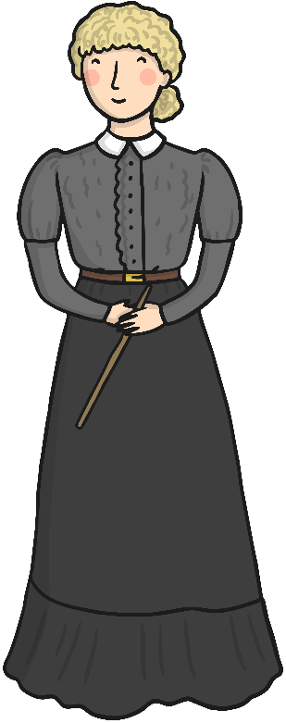
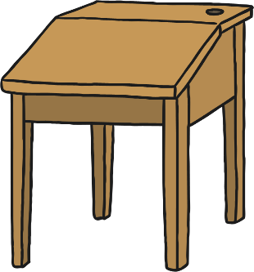
What Were the Classrooms Like in the Past?
Click on each object to read some information.
The teacher stood up or sat on a tall chair at the front so they could easily see all the children.
School children sat on benches behind their own wooden desks. Sometimes, five children had to squeeze onto a bench made for two.
Classrooms were very big and had no carpet. There was a single coal-fuelled iron stove at the front near the teacher, but children at the back would often be very cold!
There was usually a world map on the wall showing the British Empire and portraits of King George V and Queen Mary.
Home

Slide 4
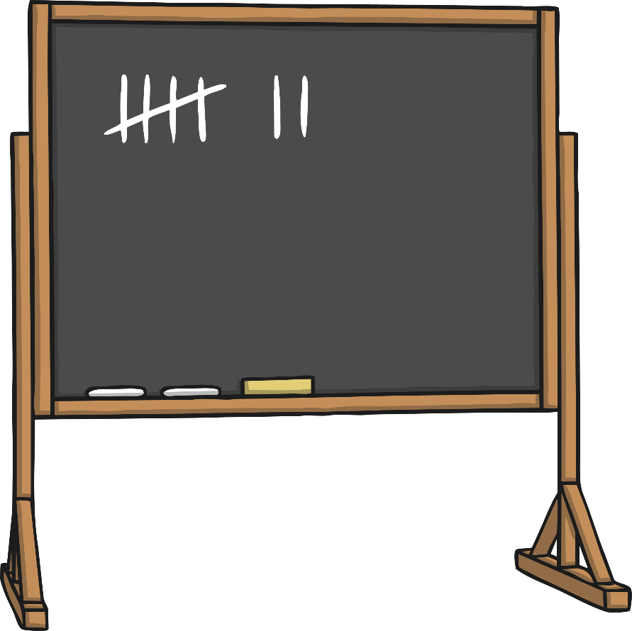
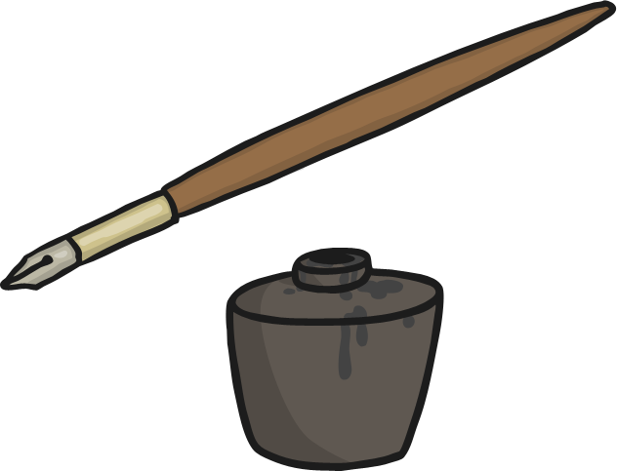
What Equipment Was Used in the Past?
Click on each object to read some information.
Children wrote on dark slate with a white squeaky, chalky 'slate pencil'. They had to spit on the slates to rub out mistakes.
Older children wrote in 'copybooks‘ with wooden ‘dip pens’. These had metal nibs they had to dip again and again into china pots of ink in a hole in their desk called ‘inkwells’.
The whole lesson would be written on a blackboard by the teacher, for the children to copy, memorise and chant aloud
word-for-word.
Home

Slide 5
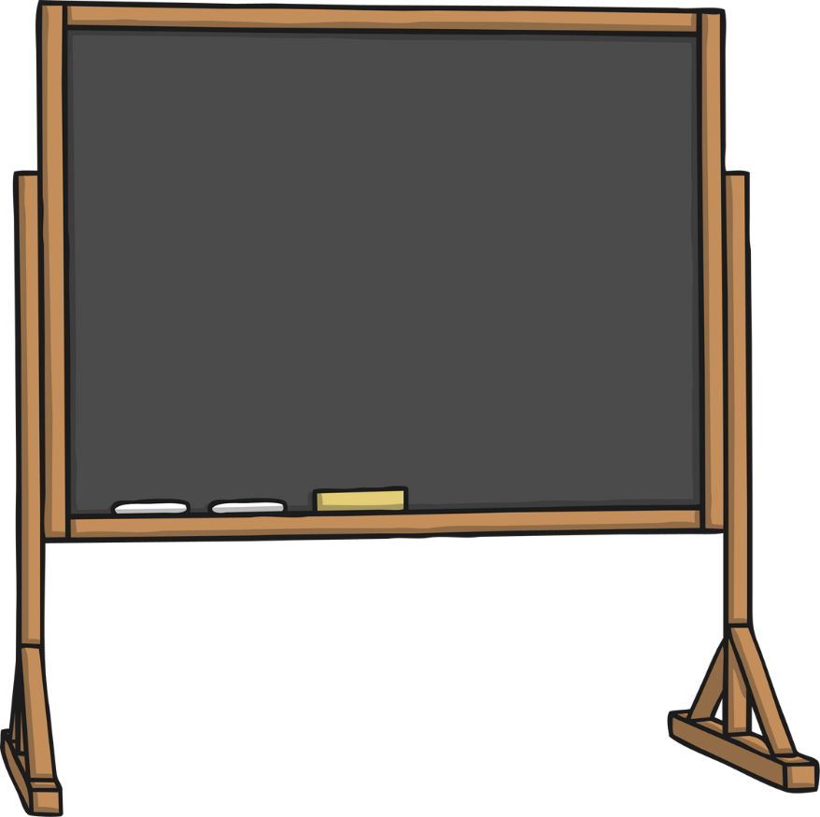
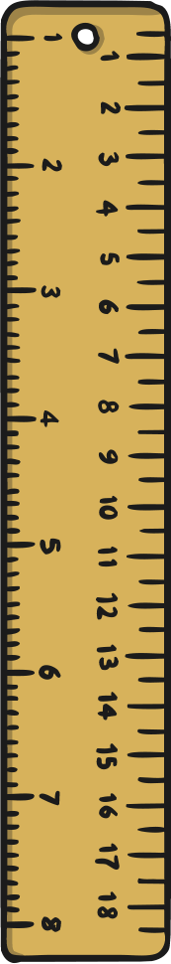


What Punishments
Were There in the Past?
Click on each object to read some information.
They were whacked with a wooden ruler on their knuckles if they were late.
I must not chatter in lesson time.
The teacher might hit a child on the hand with a wooden cane if they were lazy, rude or broke other school rules. In 1986, the cane was finally banned in most schools but some private, fee-paying schools continued to use them until 1998.
I must not chatter in lesson time.
There were strict punishments for children. No one wanted to be the ‘class dunce’ – this would mean sitting in the corner wearing the dunce's cap. The tall pointed paper hat usually had the letter 'D' or the word 'Dunce' written on it, which meant
'stupid person'.
I must not chatter in lesson time.
I must not chatter in lesson time.
I mu
Children had to stay after school and write 'I must not chatter in lesson time‘ one hundred times if they were caught talking.
Home

Slide 6
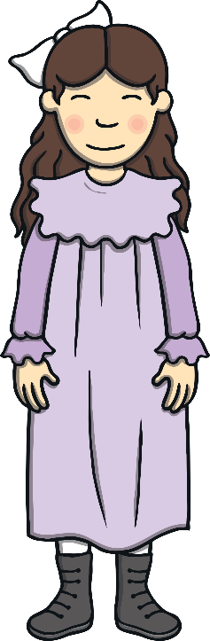
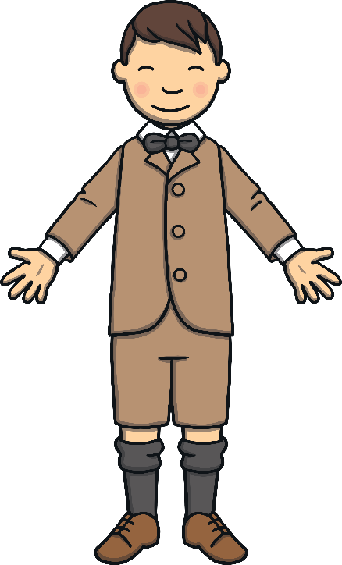
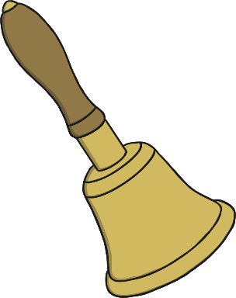
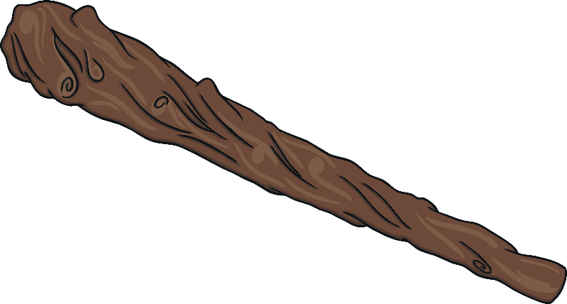
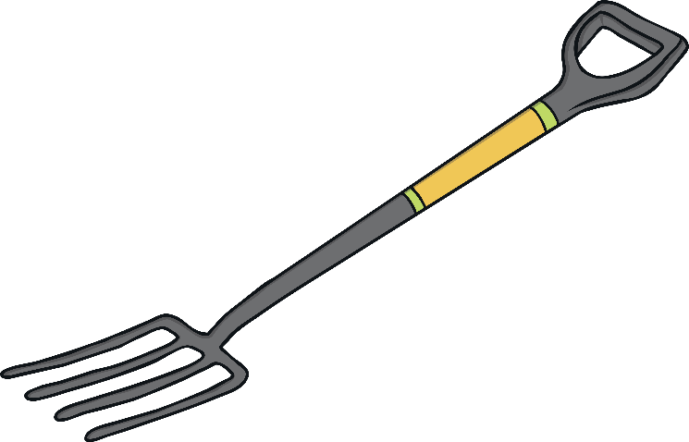
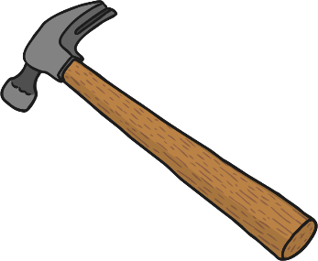
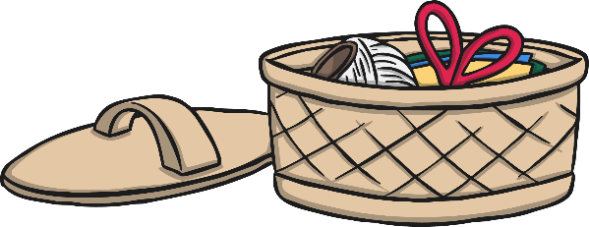
What Was the Teaching and Learning Like in the Past?
Click on each object to read some information.
Some schools taught crafts or trades in the afternoons that would be useful in later life, but would be different for girls and boys. Boys would be taught carpentry, and girls learnt how to sew, knit, cook and use a flat iron. Some girls and boys were also taught gardening.
Children took part in PE lessons called 'drills'. They had to march on the spot, do simple stretches and swing big wooden clubs around, to work on their strength. Sometimes, boys also took part in boxing lessons.
Teachers were very strict and there were sometimes more than 60 children in a class! Boys and girls were taught separately if the school was big.
Pupils who behaved well, were given special classroom ‘monitor’ jobs, including ‘Bell Ringer’, ‘Ink Monitor’ and ‘Blackboard Monitor’.
Home

