Slide 1

What is this?
How many pop up elements does it have?
Is it effective?

Slide 2

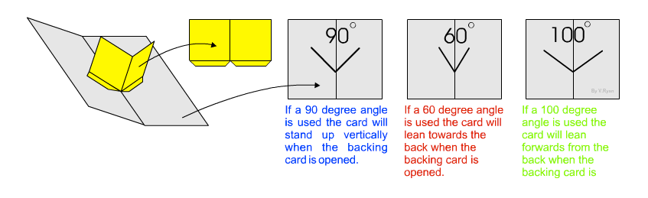
The V Fold
V-folding mechanisms are very popular and they are simple to make.
The angle used for the pop-up centre determines the way it stands up in the middle of the card, when it is opened. The pop-up has tabs that are used for gluing to either side of the card. Remember that the angle must be selected carefully.

Slide 3
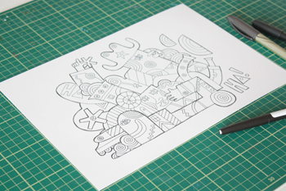
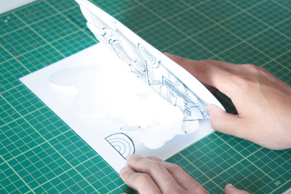
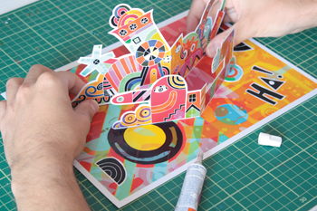
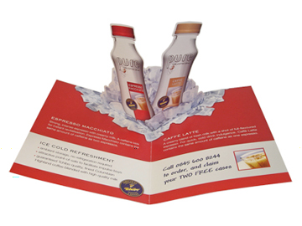



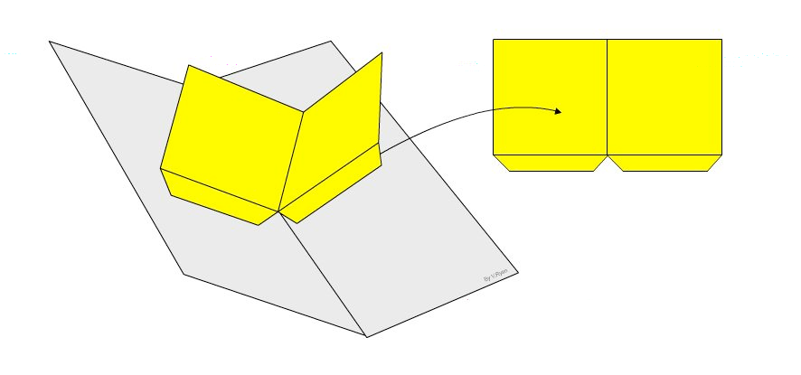
The V - Fold

Slide 4
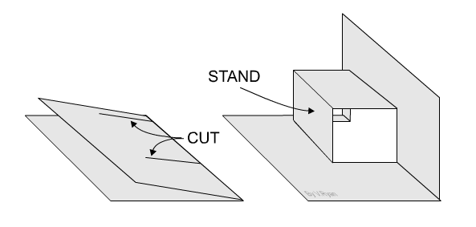
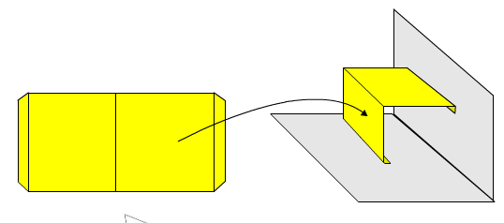
The Internal Stand
ANd
Parallelogram Pop ups
The parallelogram pop up is made by making a separate stand out of card and attaching it to the base card.
The internal stand is made by making cuts into the base card.

Slide 5
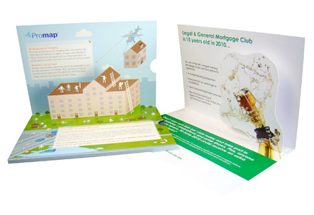


They can be complex with multiple layers/steps.
They can be simple - with only one layer.

Slide 6
What are the names of the pop ups we have looked at?
Describe them
Uses one piece of card and that is stuck across a fold.
Needs to be placed at the back of the card.
V - Fold
Internal stand
Is made up from 2 two cuts into the base card.
These are pushed forward and things can be stuck to these.
Parallelogram
Looks like an internal stand BUT uses separate piece of card instead of cutting the base card.

Slide 7







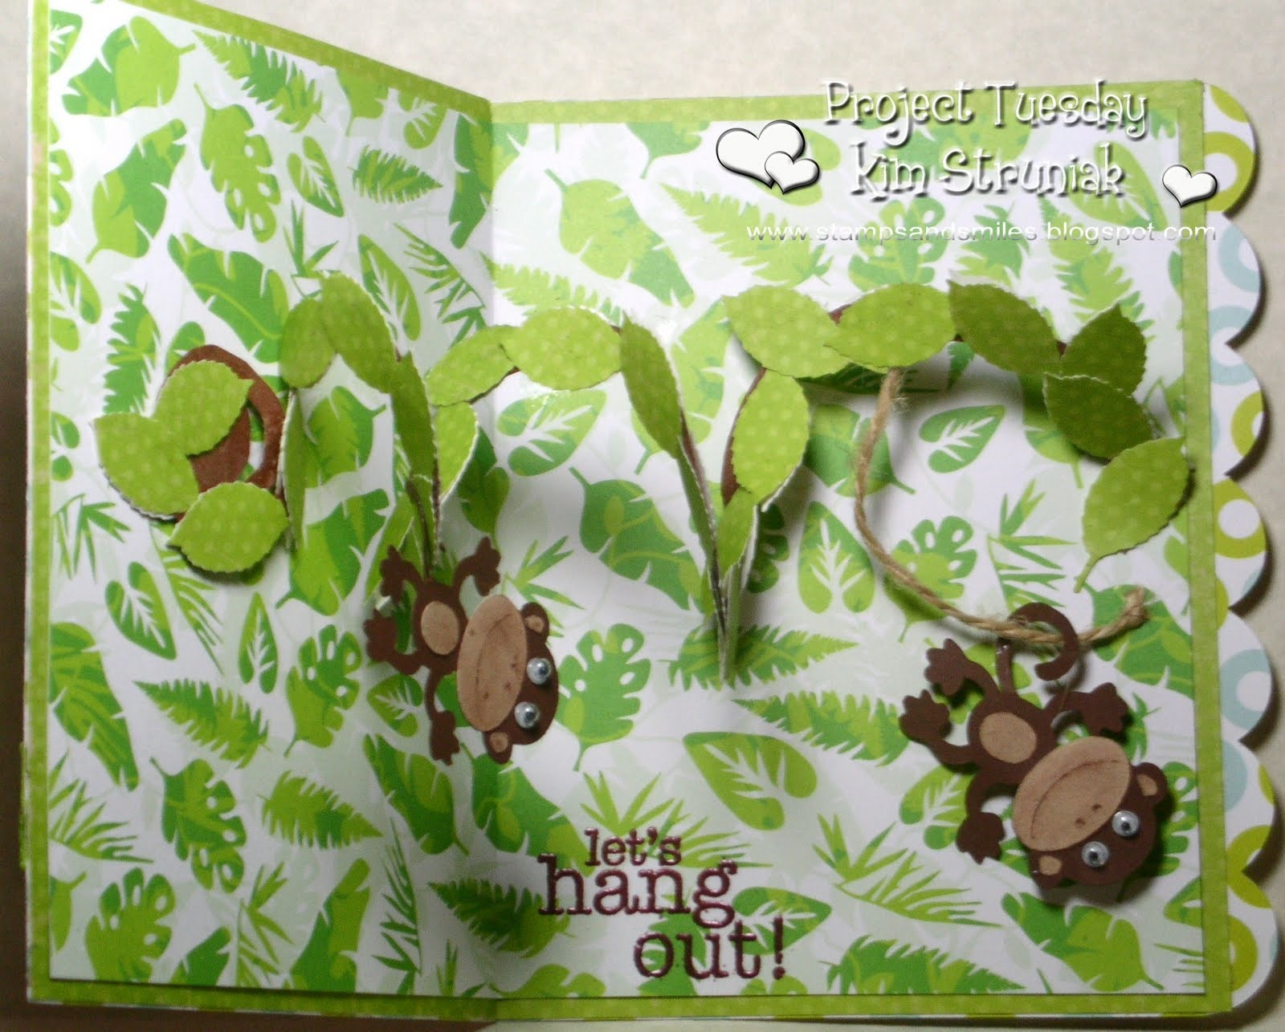
Spiral Pop Up

