Slide 1


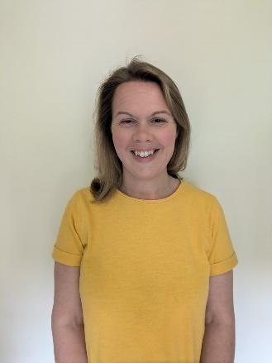
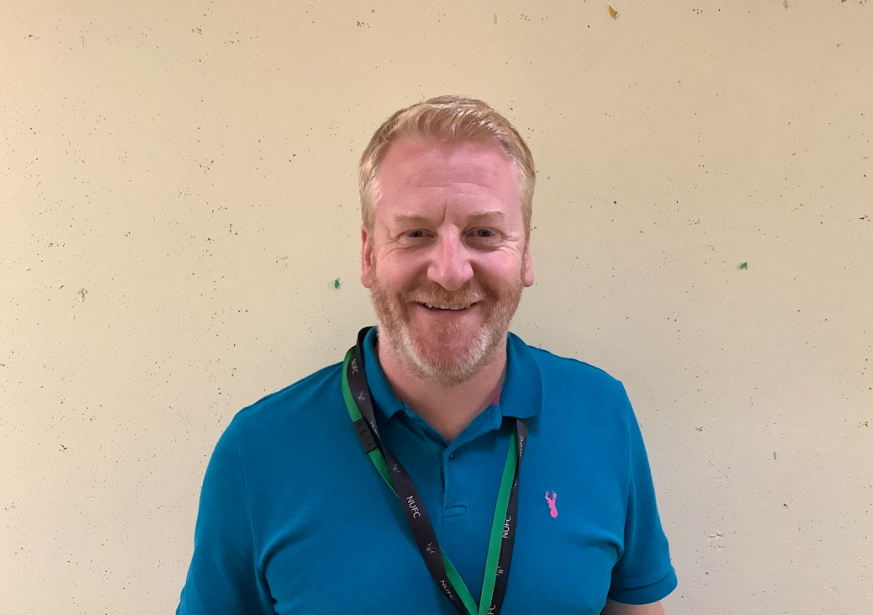
Meet the Teachers!
Mr Mullen & Mrs Gibbins
Mrs Nish, Mrs Jackson, Mrs Clarke &
Mrs Dales will also be working to
support Year 5.

Slide 2
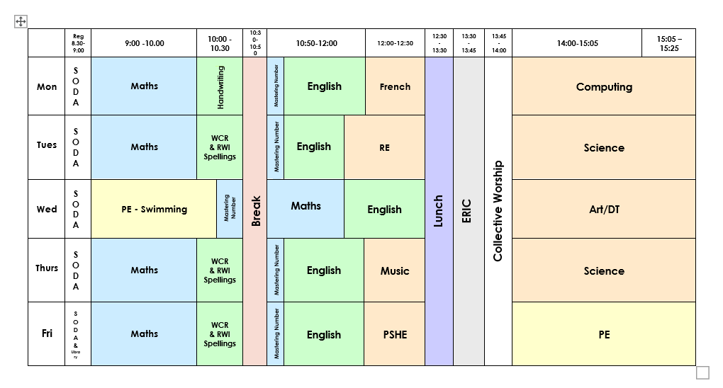
Timetable

Slide 3
Trips and Visitors
We are hoping to plan some exciting visits both inside and outside school to extend our learning and to bring our topics alive! Our proposed plan is as follows but is subject to availability:
Autumn Term – Chiltern Rangers Whiteleaf Cross & Local Churches
Spring Term – Energise
Summer Term – Science Oxford

Slide 4
Reading
Your child will learn reading skills during Whole Class Reading sessions in class.
To encourage the children to read for pleasure we will read a class novel each day.
These are skills which will then be practiced at home. We want children to enjoy reading and sharing books with you!
Children will be able to log their reading in their Reading Record. We will continue with the Red Ted reading reward scheme – see next slide for more information.

Slide 5
RED TED
RED TED stands for Read Every Day, Talk Every Day. We expect children to read at home with an adult at least 3-5 times a week depending on their age, to help them develop and practice their reading skills. Children will only ever be sent home with books that are matched to their current phonic ability. Once children have become confident, fluent readers, they will come off of the RWI reading scheme and become a 'free reader' and choose books from the class book trolley.
How can my child earn rewards?
Children can earn rewards by reading at home. This can be with an adult or independently – it just needs to be written in their reading record, which should already be in school every day. This is not expected to be a whole book, but around 5-10 minutes of reading depending on the age of your child. Children need to show the adults in their class their reading record (adults may ask them questions about the book to check!) and once they have completed 10 reads, they will receive their very first reward! They can earn up to five reads in a school week - that’s one read a day!
What are the rewards?
10 reads = A RED TED sticker (You will receive a sticker for each multiple of ten reads you collect)
100 reads = A trip to the Head teacher's office to choose a book from her special RED TED library
200 reads = A book and a RED TED badge
300 reads = A book and a RED TED wristband
400 reads = A book and a RED TED teddy
500 reads = A visit to the Office to choose a book on the computer
600, 700, 800, 900 reads = A £5.00 book token
1000 reads = mystery prize!
For every 100 reads after 1000 reads, children will continue to be rewarded with a choice of book.
RED TED runs from Reception to Year 2 and then Year 3 to Year 6. Ask Mrs Horton if you have any more questions!

Slide 6
Writing
To ensure maximum progress for all pupils, we will continue to implement the new writing framework. The children will be introduced with an exciting ‘hook’ to inspire and ignite learning.
The children will then engage with the writing process: planning, drafting, editing and publishing their work.

Slide 7
Maths
The key focus for Maths is fluency, reasoning and problem solving in all lessons accessible for all children. This is an area we will continue to develop this year.
We encourage you to help your children with the recall of multiplication and associated division facts.

Slide 8
PE
Wednesday – Swimming until October half-term.
Friday – Games.
Children will need to come into school in their PE Kit on Wednesday and Friday. If it is cold on a Friday, children will need to ensure they have long, plain, black tracksuit trousers and a tracksuit top.
Earrings need to be removed for all PE sessions. If this is not possible for any reason, it is your child’s responsibility to cover them with the appropriate tape.

Slide 9
Homework
Homework will consist of English and Maths, set weekly using Atom Learning, which can be accessed online using your child’s unique username and password.
Learning logs will be set once a half term and children will have two weeks to complete their learning logs - these will be a more creative task.
Reading - Please encourage your children to read daily and log the reading they have done in their Reading Record book.

Slide 10
Rewards and Sanctions
Everybody at Monks Risborough believes in praising positive
behaviour and hard work!
Thriving Champion
House points
Stickers
Verbal praise
Values Passport stamps - when your child consistently demonstrates a value they will receive a stamp. When they have collected enough stamps they can exchange this for a reward.

Slide 11
Rewards and Sanctions
Behaviour Thermometer
If a child repeatedly disrupts the class then they will be put onto the behaviour thermometer and will miss part of break to think about their behaviour.
If the teacher has to then speak to the child again, they will move up the thermometer and the consequences will increase.
Children may go straight onto a higher level of the behaviour thermometer depending on their behaviour.
Each day is a fresh start for the children.

Slide 12
Website
https://www.mrisborough.bucks.sch.uk/
Class Page
https://www.mrisborough.bucks.sch.uk/falcons/

Slide 13
General Reminders
Uniform (names in clothes)
Water bottles
Fruit or Vegetable snack at playtimes
Please limit the items children are bringing to school with them each day. All stationary is being supplied by the school.

Slide 14
Any Questions
Please send any general questions into the school office.
Otherwise please request a phone call via office@monks.org.uk to discuss your child personally.

