Slide 2
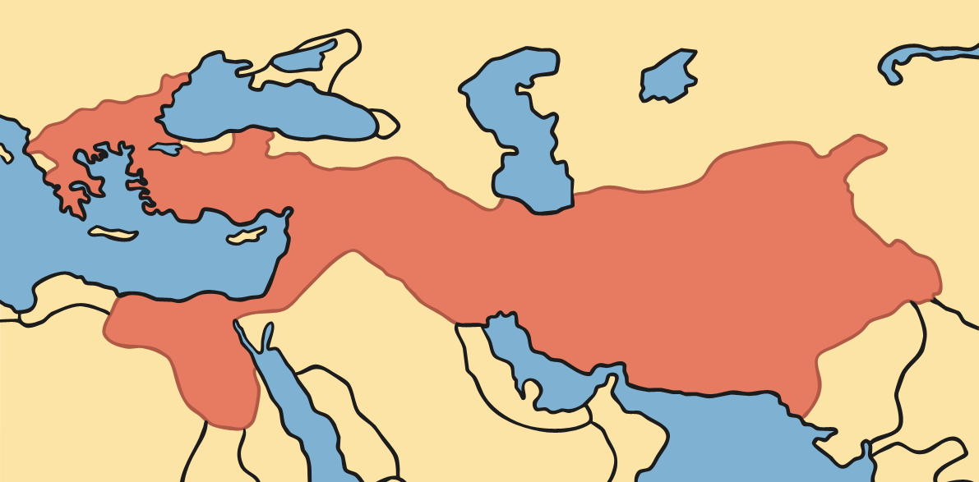
When Did the Olympics Begin?
Over two thousand seven hundred years ago, the Olympics began as part of a religious festival in Olympia in ancient Greece.

Slide 3
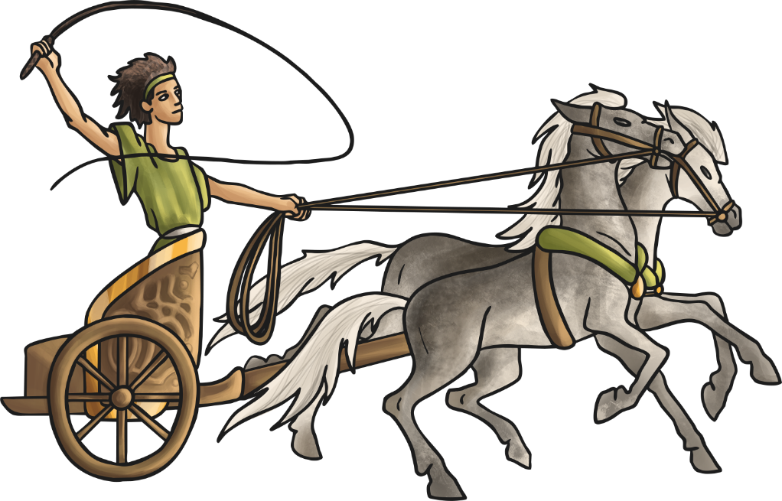
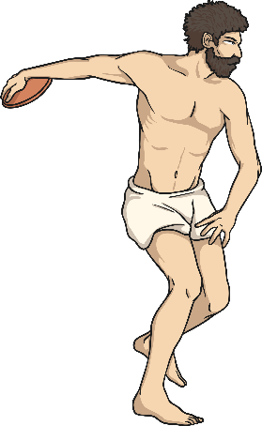
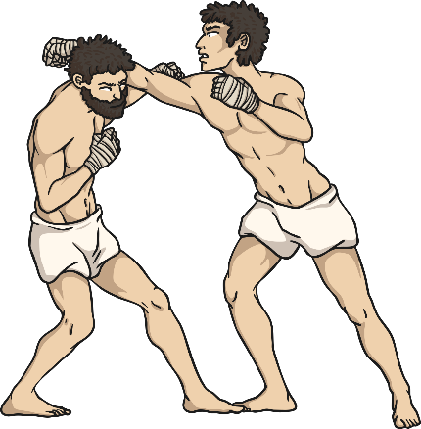
Ancient Greek Games
The Greeks took part in the Olympic Games to celebrate the Greek gods, Zeus and Hera. Only men and boys were allowed to take part and in the events, which included wrestling, boxing, long jump, javelin, discus, and chariot racing. The games occurred every four years, until the Greek Empire was defeated and they were forgotten about.

Slide 4
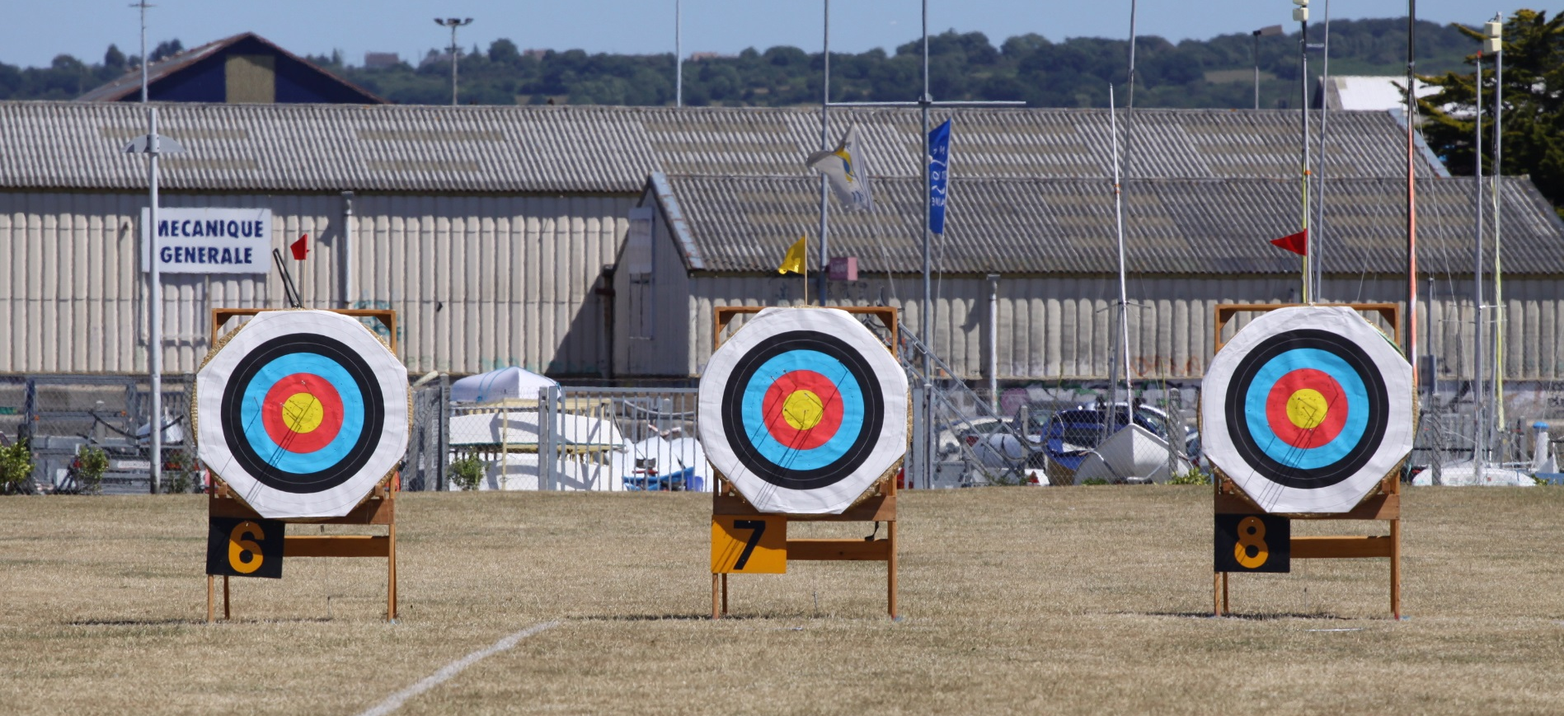
Ancient Greek Games
In 1894, the games were resurrected and the International Olympic Committee was formed.
The Olympic Games have taken place every four years since, with athletes from all over the world taking part in different events.
Photo courtesy of loicwood (@flickr.com) - granted under creative commons licence - attribution

Slide 5
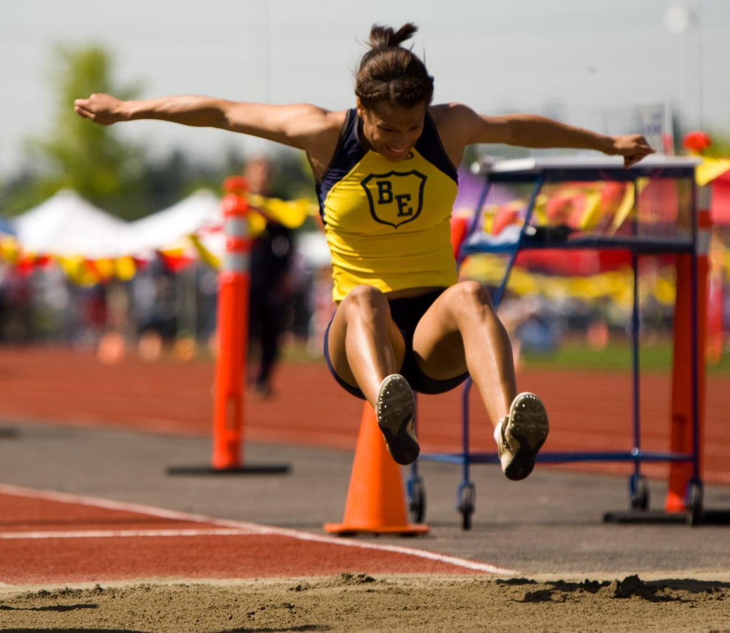
Olympic Events
long jump
Photo courtesy of Philo Nordlund (@flickr.com) - granted under creative commons licence - attribution

Slide 6
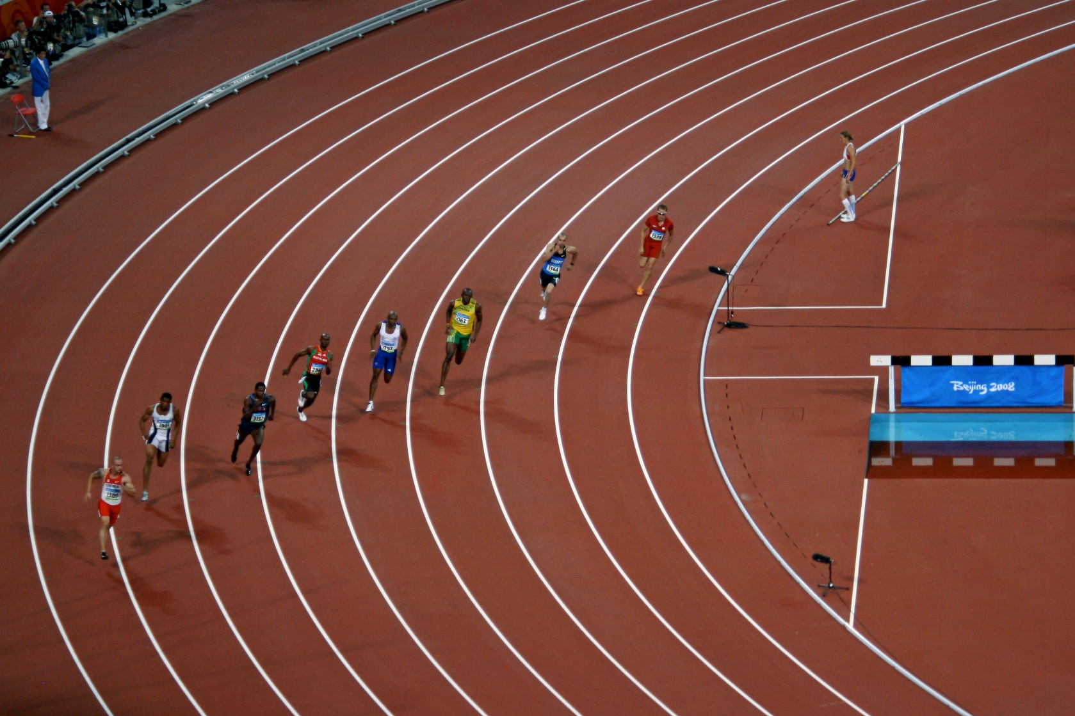
Olympic Events
running
Photo courtesy of eviltomthai. (@flickr.com) - granted under creative commons licence - attribution

Slide 7
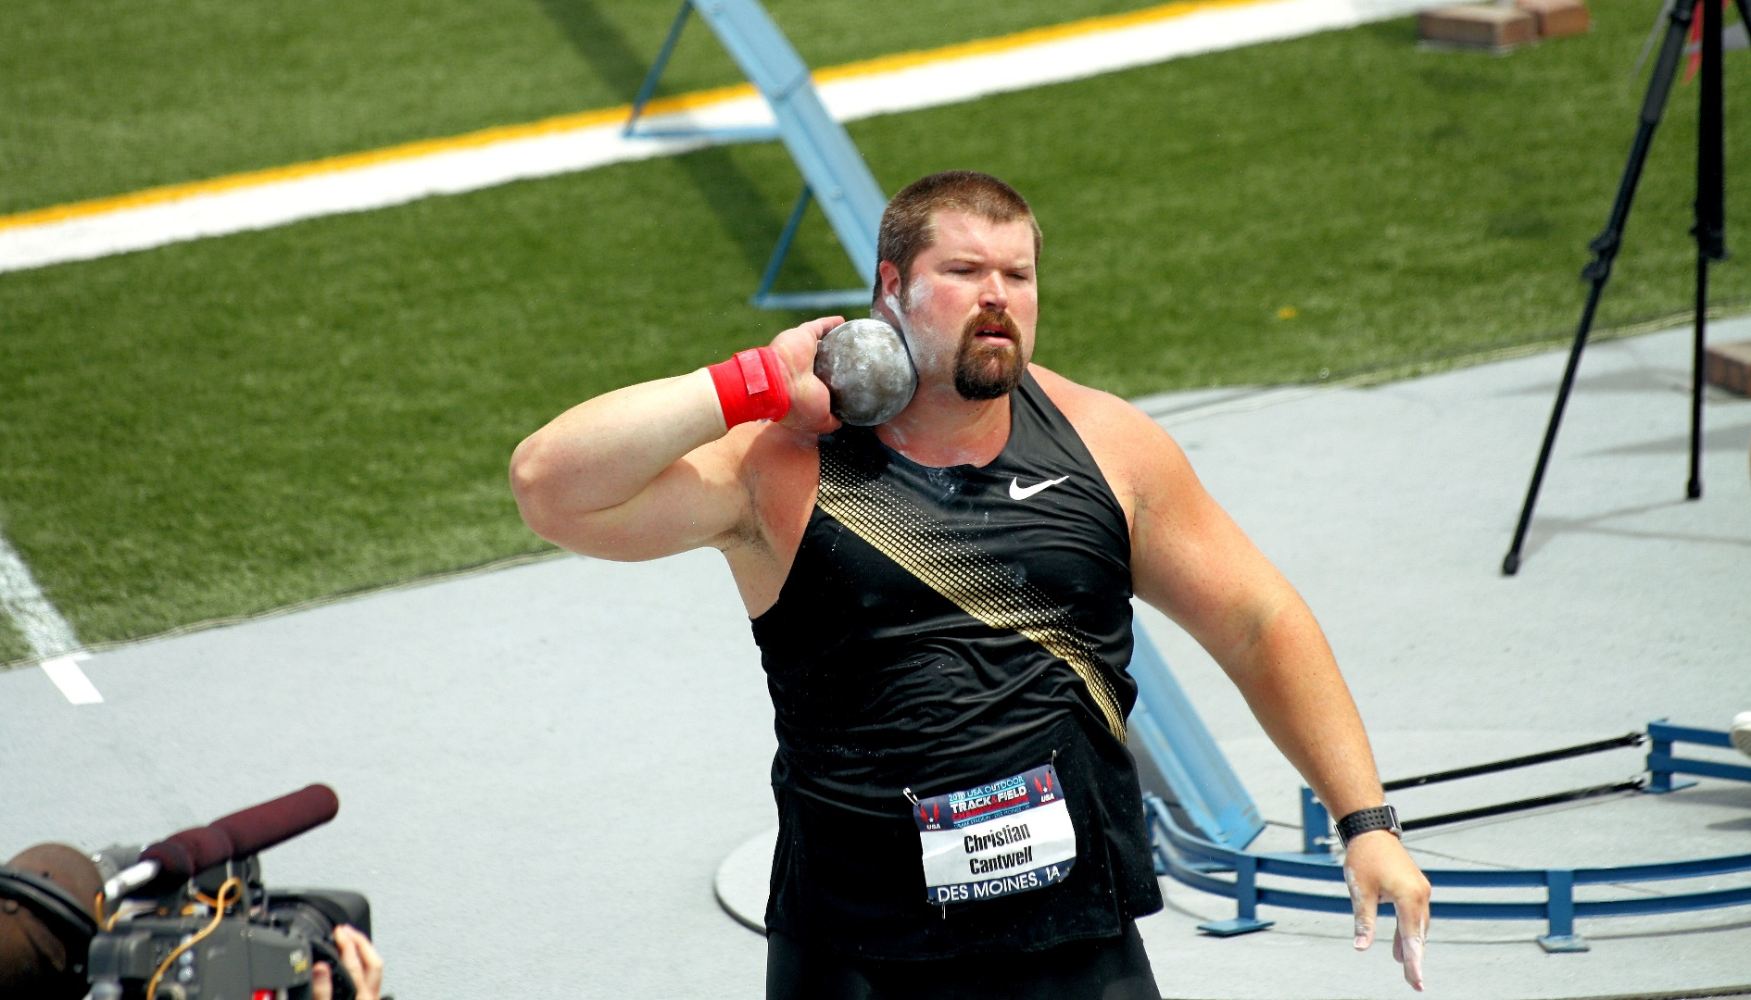
Olympic Events
shot-put
Photo courtesy of Phil Roeder (@flickr.com) - granted under creative commons licence - attribution

Slide 8
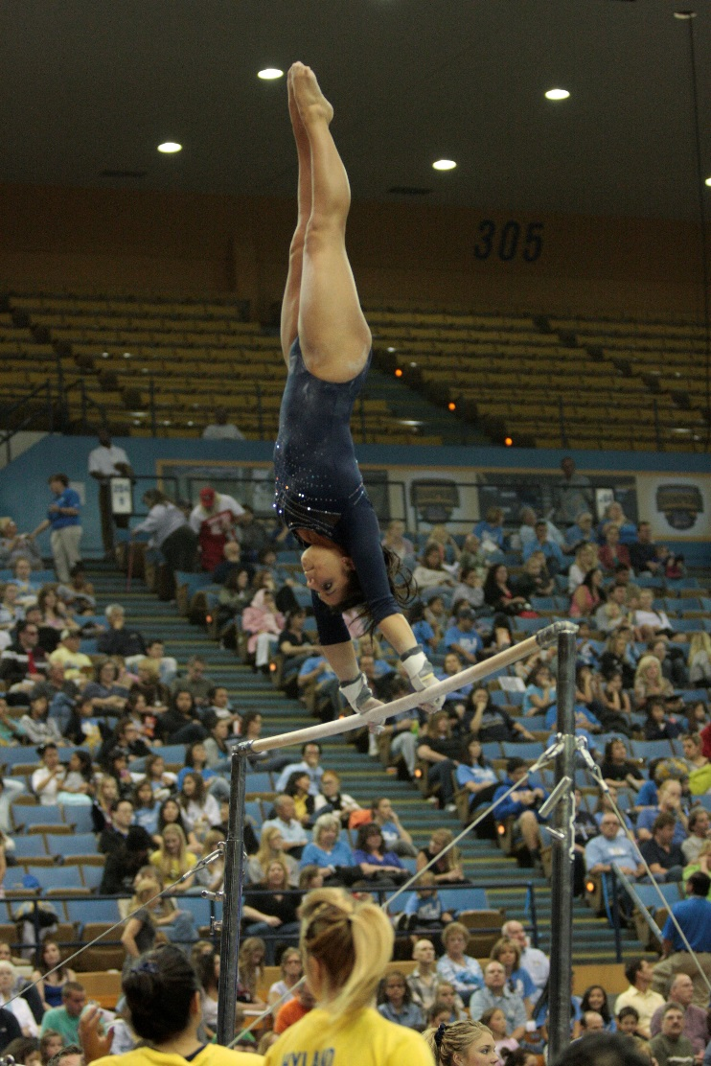
Olympic Events
gymnastics
Photo courtesy of TimWilson (@flickr.com) - granted under creative commons licence - attribution

Slide 9
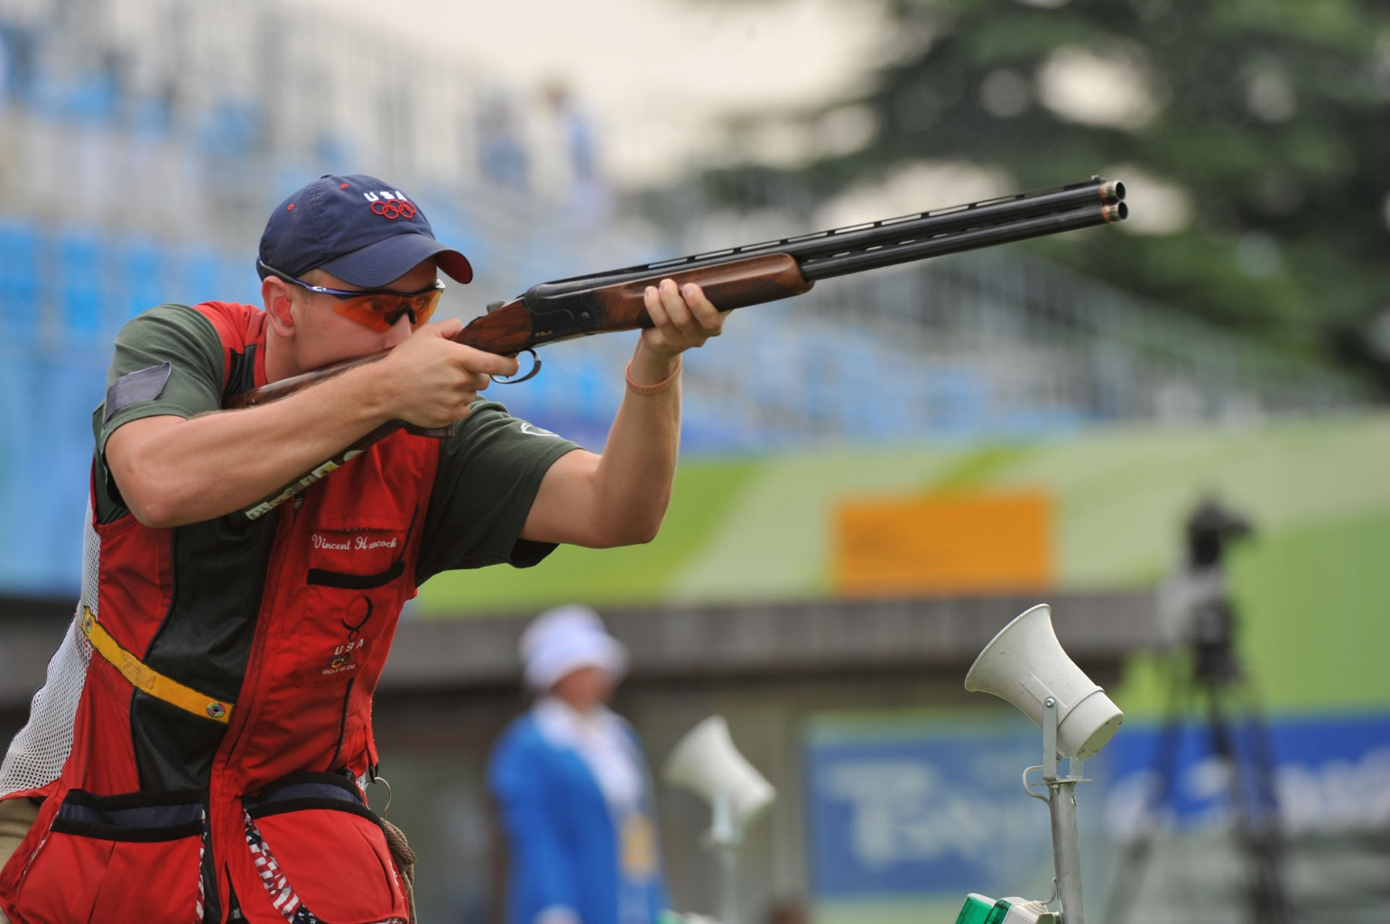
Olympic Events
shooting
gymnastics
Photo courtesy of The U.S. Army (@flickr.com) - granted under creative commons licence - attribution

Slide 10
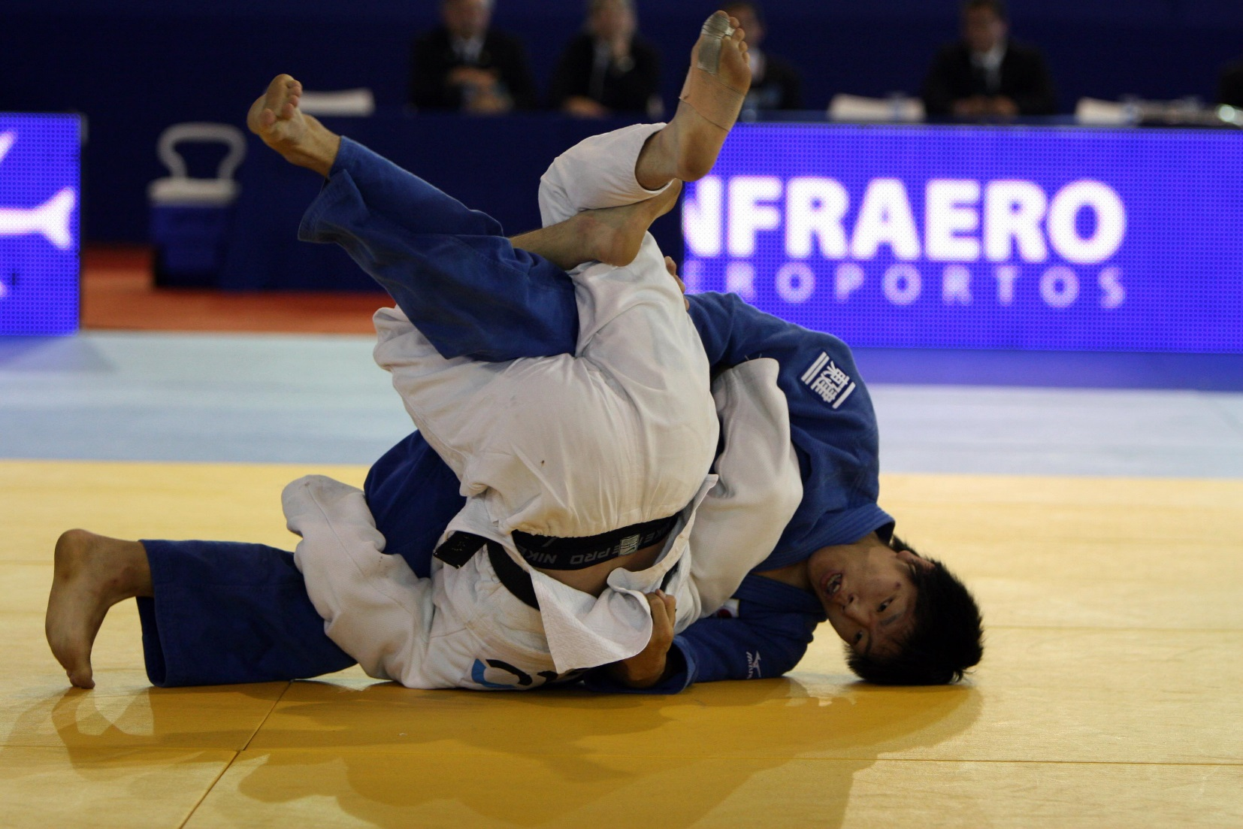
Olympic Events
gymnastics
judo
Photo courtesy of GovBa (@flickr.com) - granted under creative commons licence - attribution

Slide 11
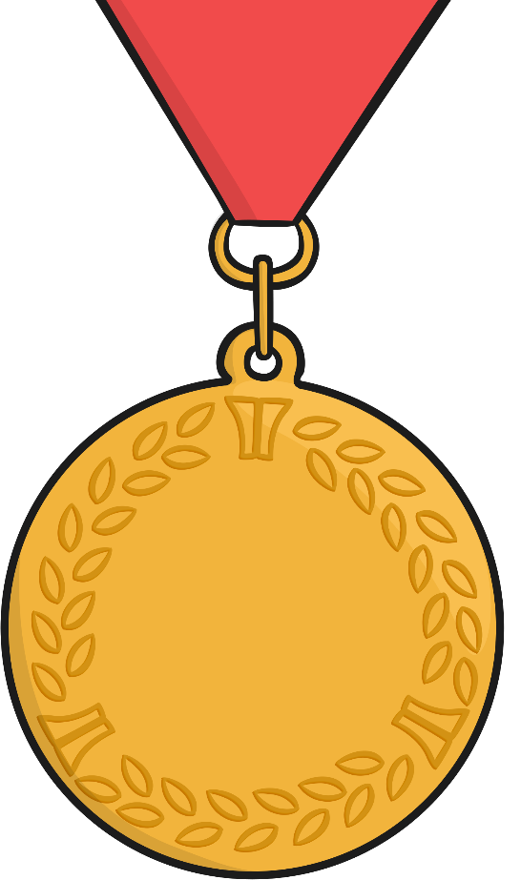
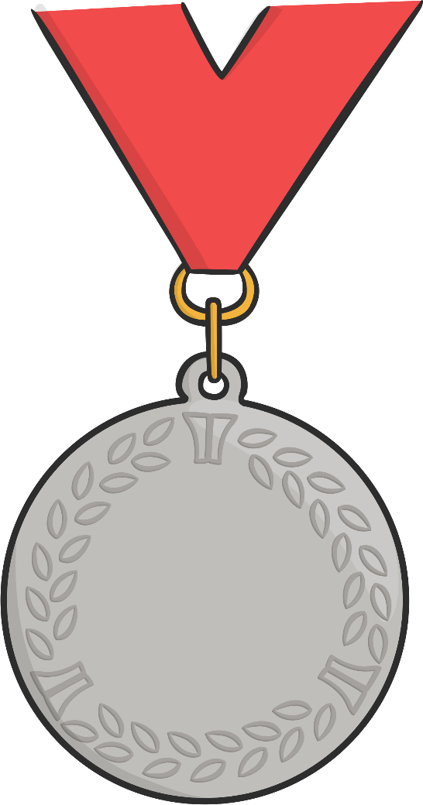
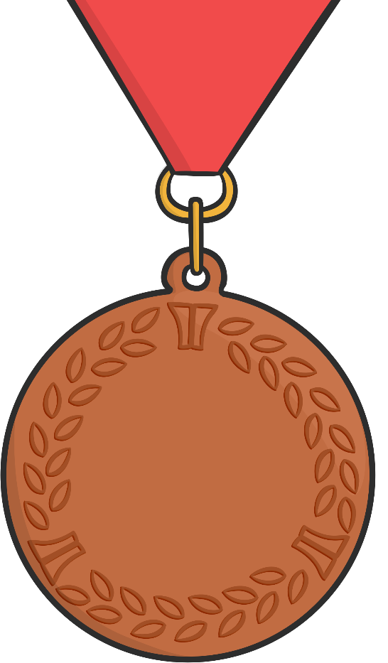
Olympic Medals
Olympic medals are awarded to athletes who come 1st, 2nd or 3rd in their event. Gold is awarded to the winner who came 1st, silver is awarded to 2nd place and bronze to 3rd place.

Slide 12
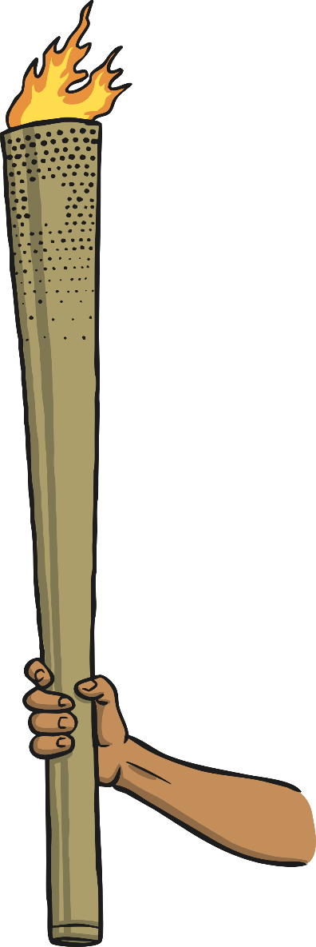
The Olympic Torch
A torch was lit outside of the Temple of Hera using flames created from rays from the Sun. Messengers took the torch around the country so that people knew about the games.
Today the torch is lit as it was during the ancient Olympic Games. The flame travels around Greece and then to the country where the games will be taking place.

Slide 13
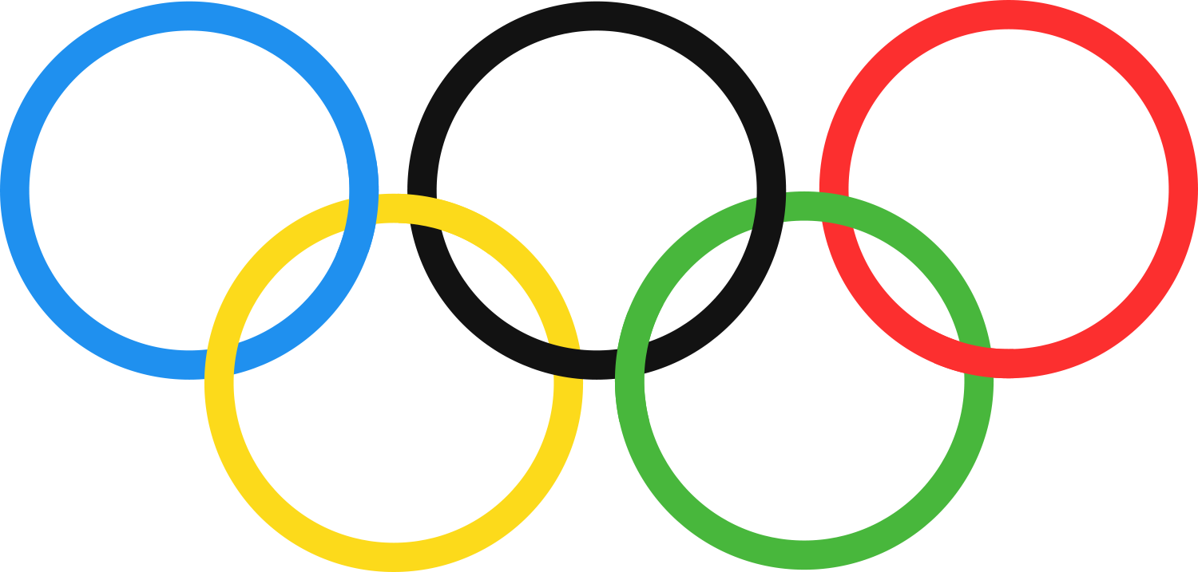
Olympic Rings
The symbol of the modern Olympic Games is five interlocking rings. The five rings are blue, yellow, black, green and red. The five rings represent the five continents, or parts of the world which took part in the first modern Olympic Games.

Slide 14
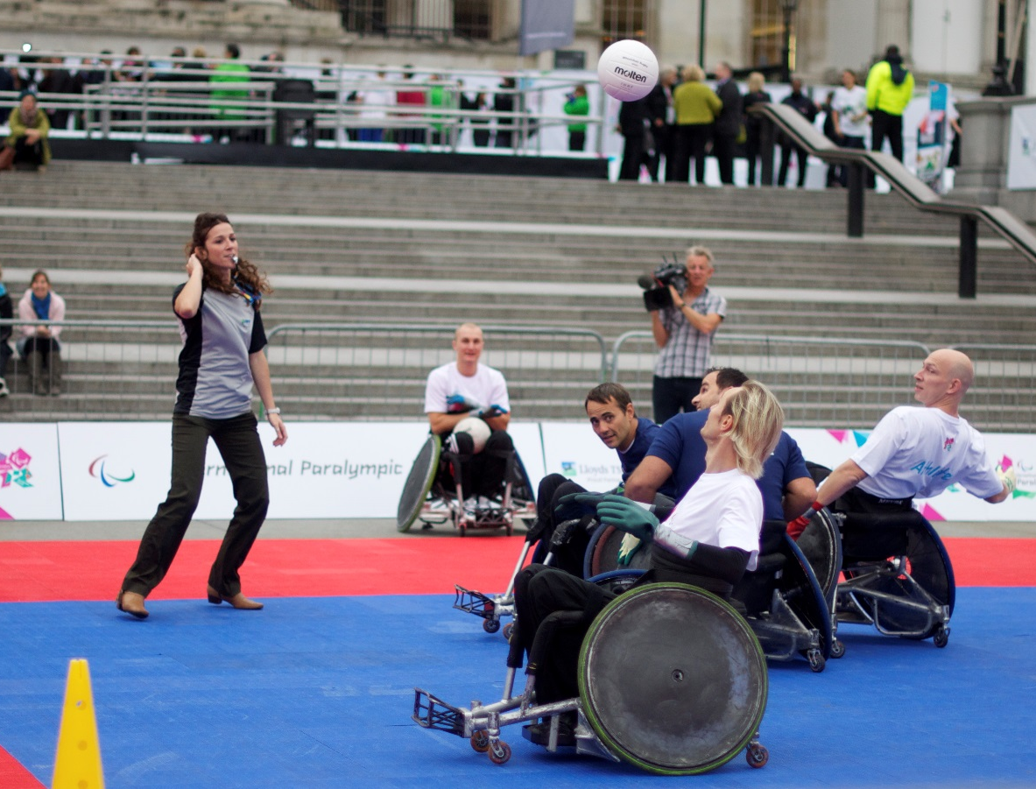
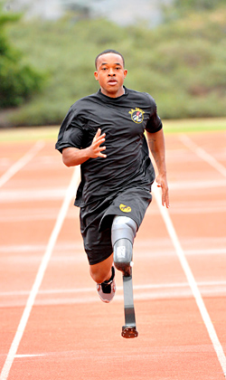
Paralympic Games
The Paralympic Games take place after the Olympic Games. Sportsmen and women who have a disability meet up and compete.
Photos courtesy of Nick J Webb familymwr (@flickr.com) - granted under creative commons licence - attribution

Slide 15
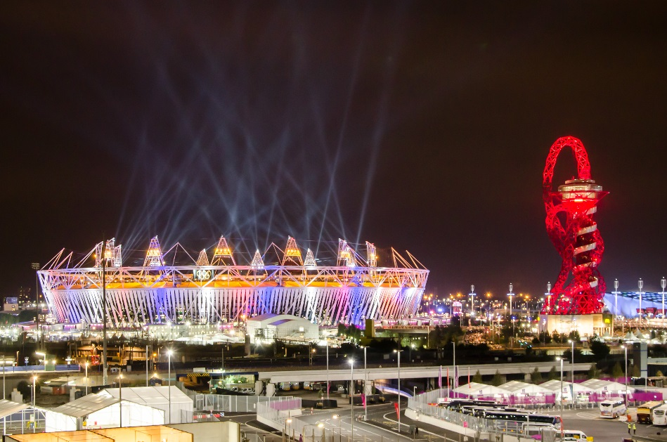
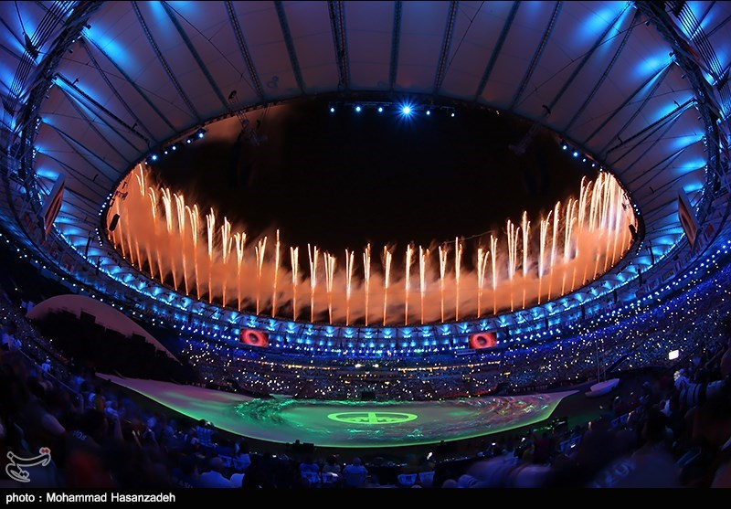
2020 Olympic Games
Each Olympic Games takes place in a different city across the world.
In 2012, London, UK was the host city.
In 2016, the Olympics were held in Rio de Janeiro, Brazil.
The next Olympics are being held in 2020 in Tokyo, Japan.
London
Rio
Photos courtesy of Alexander Kachkaev and papparazzi..... (@flickr.com) - granted under creative commons licence - attribution

