Slide 1
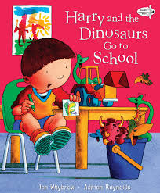


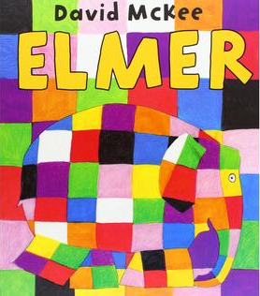


What Makes a Good Friend?
This first topic in Reception will support children to settle happily into their new classroom and routines. It encourages them to explore their new setting, understand expectations, build positive relationships with others (introducing the school value of ‘Friendship’), and talk about themselves and their experiences. Adults will be able to develop learning opportunities based on children’s emerging interests and needs.
Personal, Social, Emotional Development
Understanding that our actions affect others
Learning ways to solve conflict
Playing together, taking turns
Building relationships with others
Understanding the school rules and expectations
Saying when we do or do not need help
Communication and Language
Listening to others
Taking turns to speak
Following instructions
Using a range of tenses
Using ‘and’ and ‘because’ to link thoughts
Asking questions
Giving explanations
Physical Development
Avoiding obstacles
Throwing and catching
Pencil control: drawing lines, circles, forming some letters
Holding pencils and tools appropriately
Using the toilet independently
Washing hands independently
Getting changed independently
Reading
Listening to a story
Joining in with a story
Recalling a story
Joining in with rhyming and rhythmic activities
Recognising our names, familiar words, and symbols
Learning how to handle books carefully
Writing
Saying what we have written
Listening to the sounds we can hear
Saying the sounds we can hear
Writing our names
Writing from left-to-right and top-to-bottom
Phonics
Developing our listening skills (environmental sounds, instrumental sounds, body percussion, rhythm & rhyme, oral blending and segmenting)
Begin learning Speed Sounds: Set 1 (Read, Write, Inc.)
Maths
Sorting: noticing difference
Comparing quantities: more/fewer/same
Quantity to 5
Introducing 5-frames
Change within 5: 5-frames
Understanding the World
Talk about starting school
Comment on/question aspects of our familiar world (homes, town, school, class, places of worship, birthdays)
Explore technological toys (telephones, story headphones, small world toys)
Expressive Arts and Design
Join in with dancing and ring games (‘getting to know you’ games)
Sing familiar songs
Explore construction materials
Explore creative materials

Slide 2
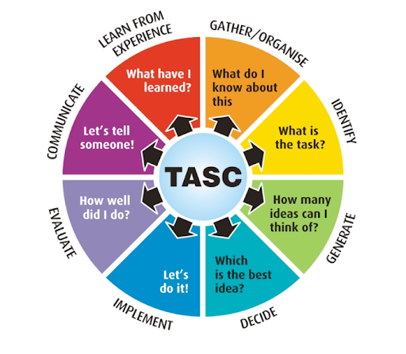
TASC
Gather- what do we know about birthday parties already? What did Kipper use for his?
Generate- come up with ideas for hosting our own party
Decide- which are the best ideas? Which ones will we use?
Communicate- share our ideas and invite others to the party
Implement- host a party!
Great Learner Skills
Collaboration Problem Solving
Creativity Critical Thinking
Perseverance Leadership
Communication Curiosity
Reflection Independence
Environment and Locality
Talking about where we live
Learning about harvest
Walking to Church to celebrate the Harvest Festival
Life Skills / Cultural Capital
Understanding the classroom and school rules
Planning a birthday party for Kipper
Parental Engagement
Sending in ‘wow’ moments from home via Tapestry
Book-look plus photos on Tapestry
Supporting home reading
Being available on the gate every morning
Key School Values
Friendship
Respect
Responsibility
Perseverance
Generosity
What Makes a Good Friend?
By the end of this topic, the children will have settled into their new classroom routines and made some positive relationships with adults and children alike. They will have begun to consider what it means to be a friend and why this might be important, and started to apply this in the classroom. They will be familiar with the resources in the room and will have begun to show different preferences and interests. They will have refined their sound discrimination skills and begun to understand the relationship between sounds in words and letters, realising that these can be used in writing to communicate meaning. Children will also have developed their understanding of, and ability to discuss, quantity through practical explorations in maths activities.

