Slide 1

Reception Maths
2024 / 2025

Slide 2
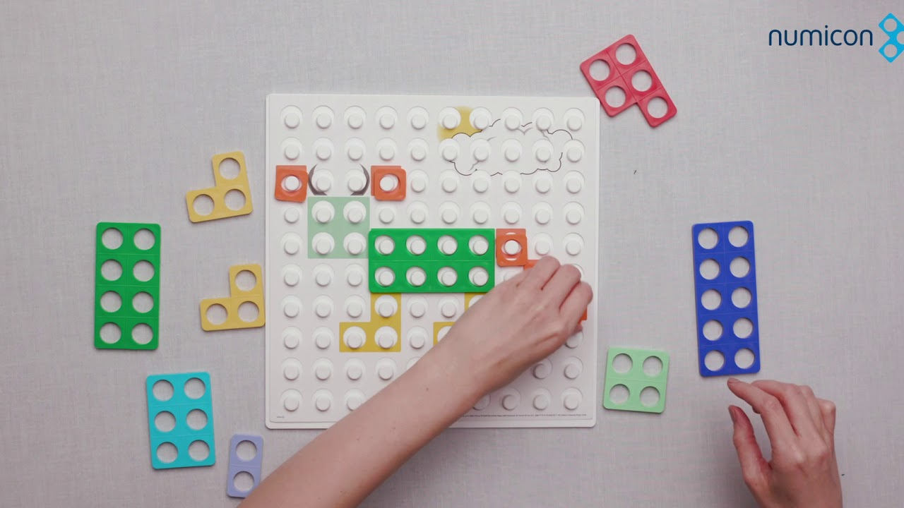
  What do we do in school?
  What does the curriculum look like?
  Useful resources – Physical, books and websites
  How you can help at home

Slide 3

The curriculum in school
BBC Number blocks scheme alongside White Rose
Maths Mastery approach, reasoning and problem solving
Books

Slide 4
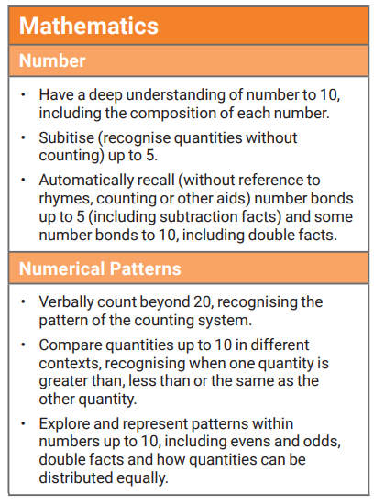
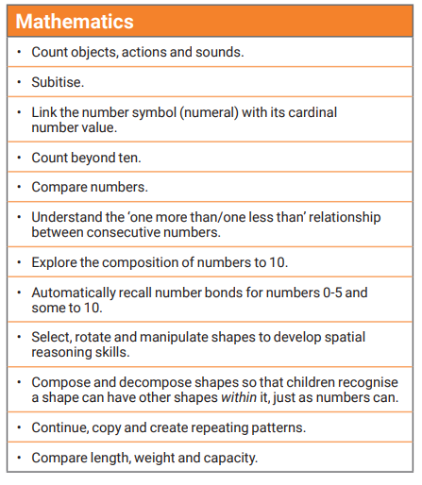
The Early Years Foundation Stage curriculum
Development Matters Statements
Early Learning Goal

Slide 5








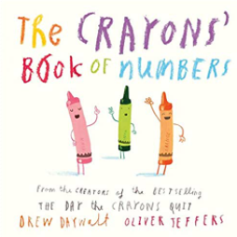

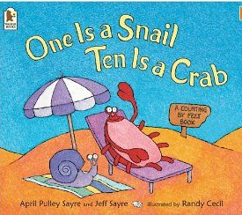
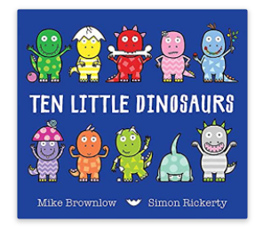
Maths books

Slide 6
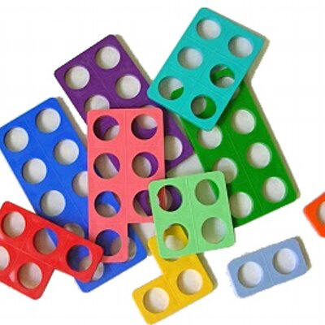

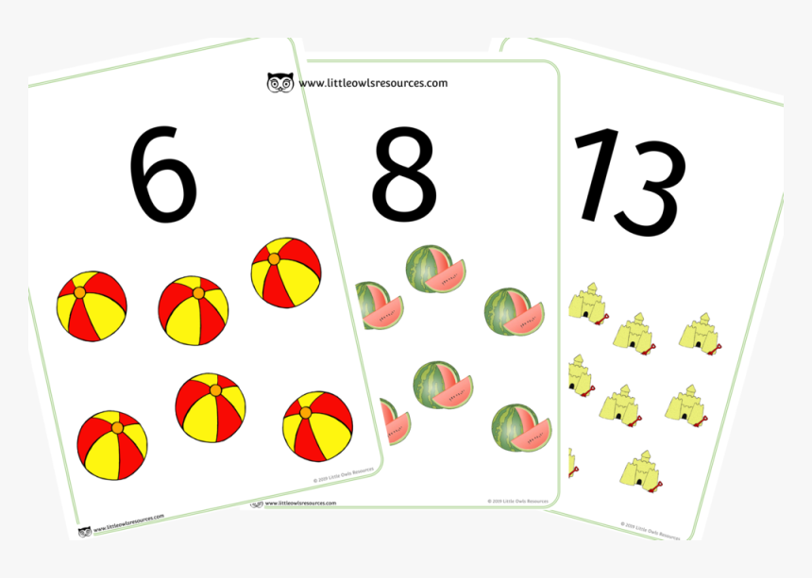
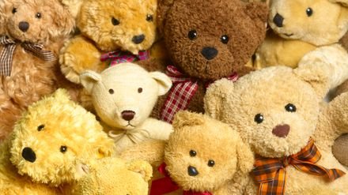
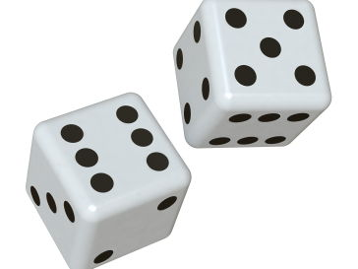
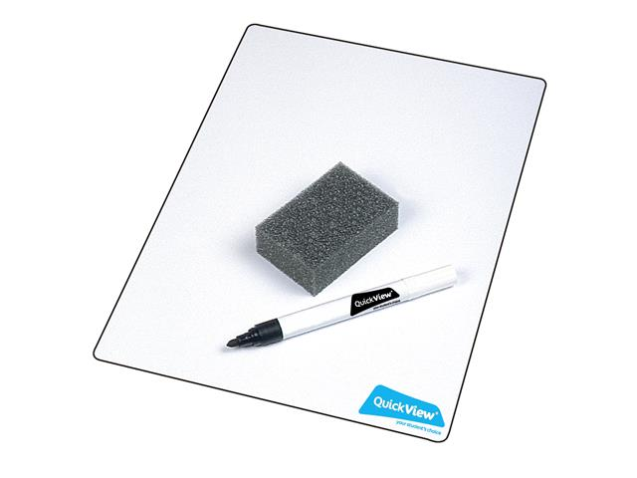
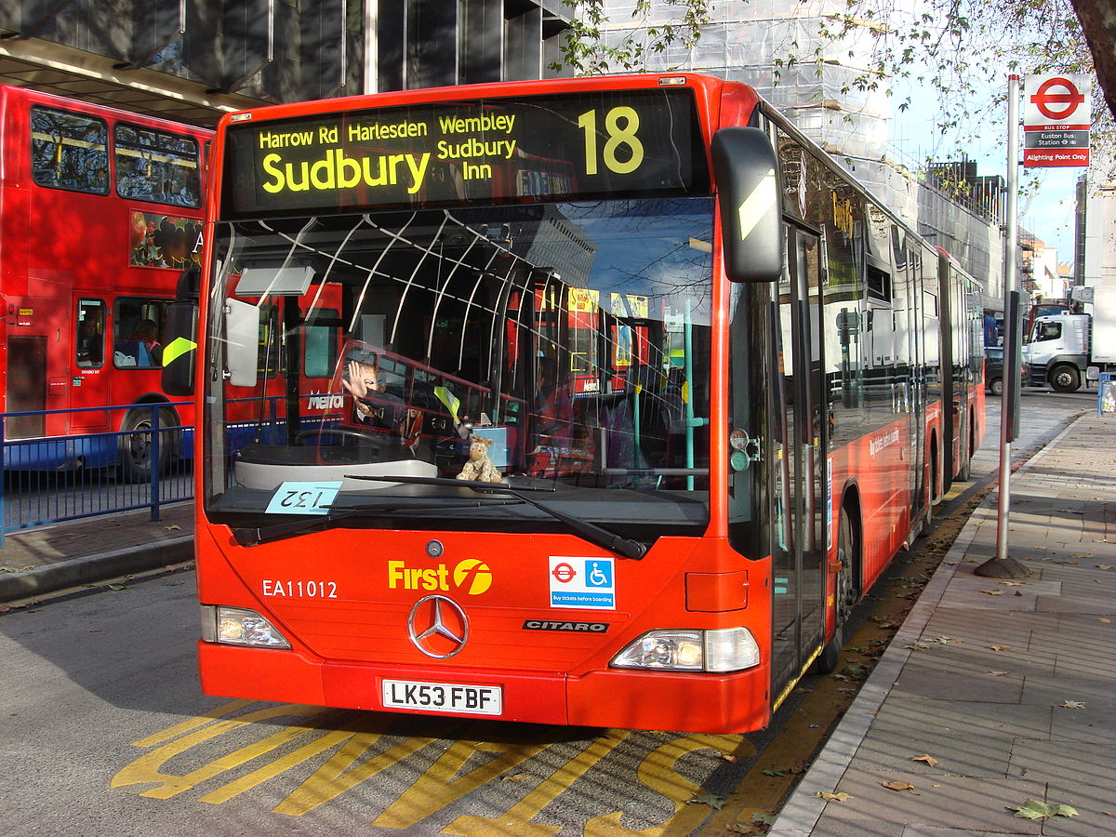
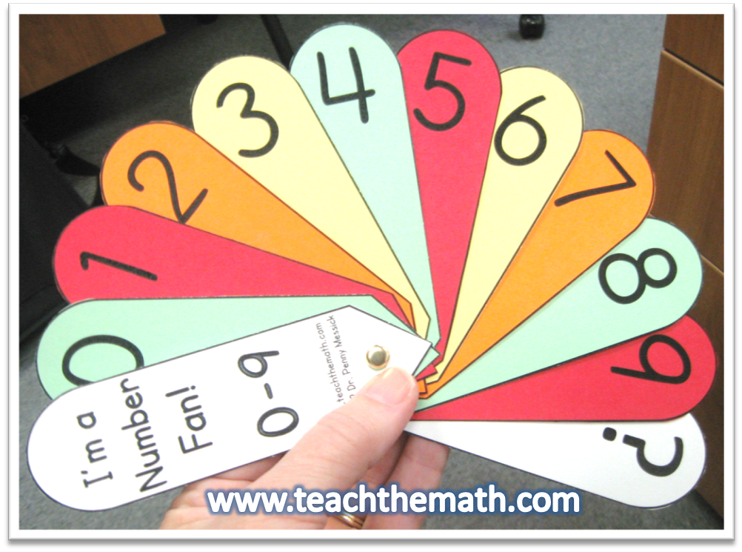
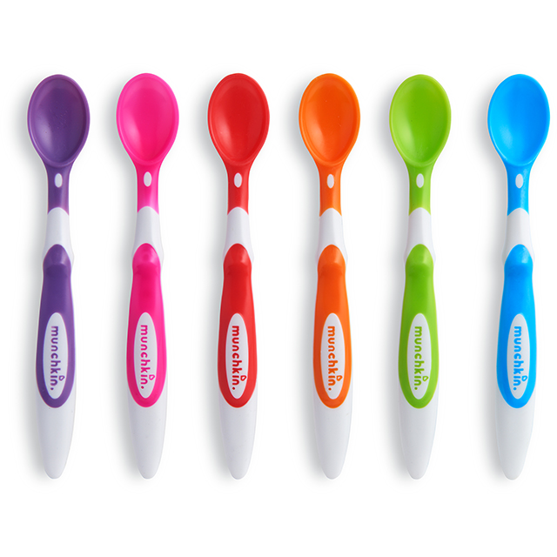

Physical resources

Slide 7

How you can help at home
Number formation
Model number writing and reading in different ways: Lists, tracing, birthday cards, buses, front doors, recipes, in books, phones
Number hunts
Write in sand, with your finger on the carpet, paint, make numbers with play dough, on a whiteboard, on paper, post it notes, on a tablet

Slide 8
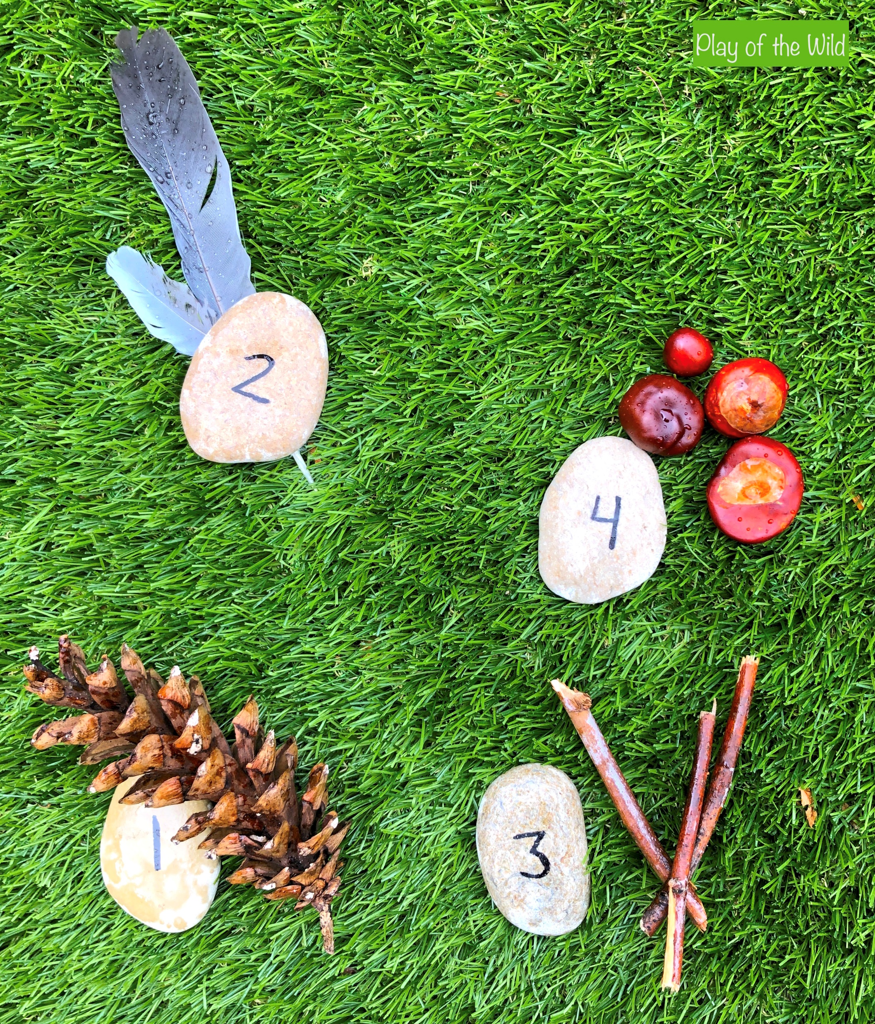
How you can help at home?
Counting
Counting – in everyday conversation, in play, steps, brushing teeth,
toys in the bath, tidying toys
Subitising (recognizing straight away how many are in a group by the shape of the group rather than having to count them (eg: numbers on a dice) – with dice, teddies, spoons, socks, natural objects outside.
Ordering numbers – flashcards, post it notes, lining up toys
Number bonds – in the car, with teddies/toys
Addition and subtraction – include it in everyday conversation, cooking

Slide 9
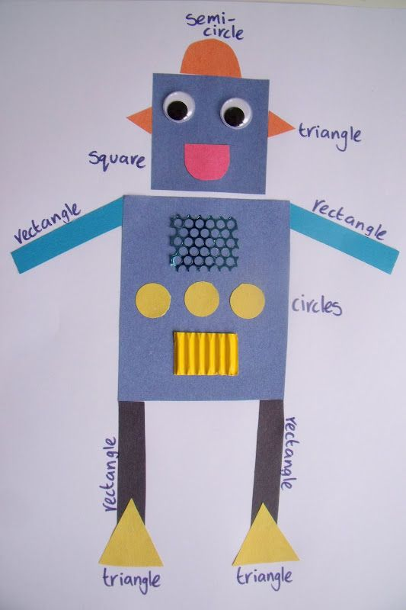
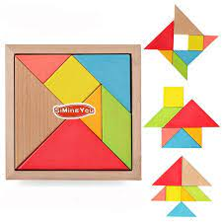
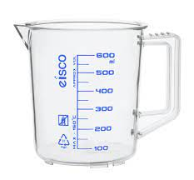
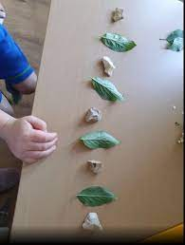
How you can help at home?
Shape and measure
2D and 3D shapes – in everyday conversation, shape hunts, shape pictures, mosaics, tangrams
Patterns – ordering objects and toys, clapping/body percussion
Weight, length, capacity, time – language focus whilst cooking, in the bath, in the sandpit, pouring drinks, talking about routines

Slide 10
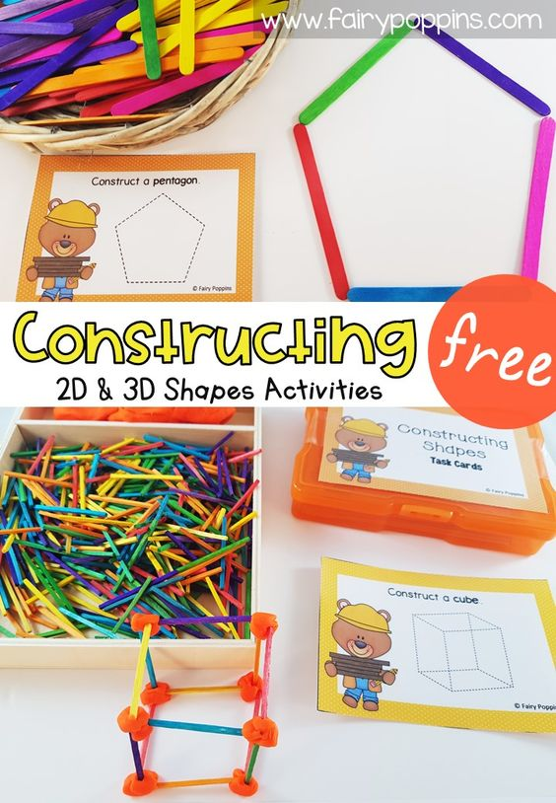
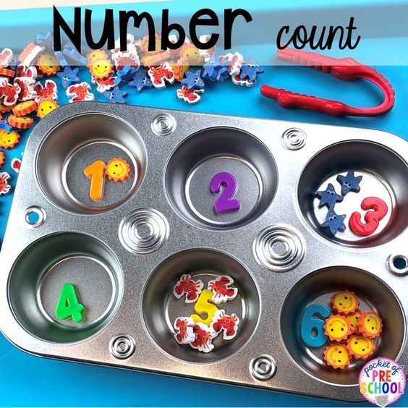
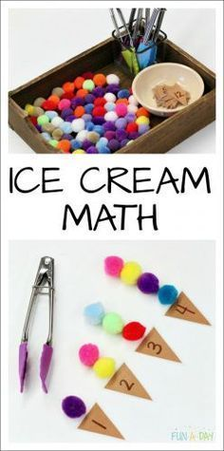
How you can help at home?
Games
Snakes and ladders
Board games
Card games – snap, pairs
Number hunts
Hide and seek
Bingo
Link it to fine motor activities
Counting songs

Slide 11
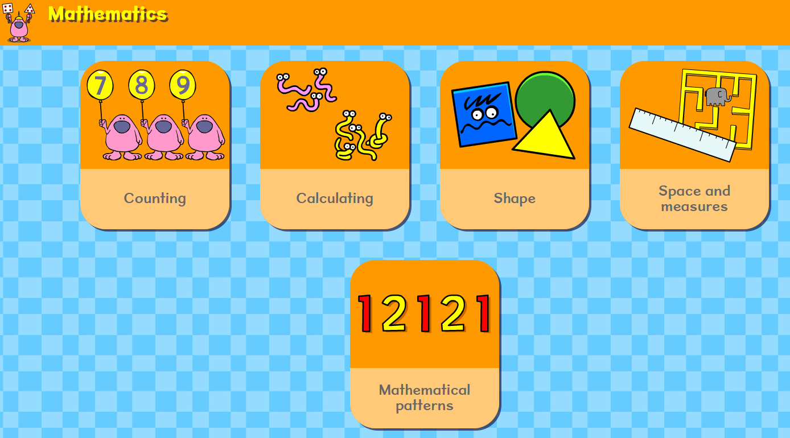
Useful websites
https://www.topmarks.co.uk/maths-games/hit-the-button - Quick fire maths
http://www.mathsphere.co.uk/resources/MathSphereSampleWorksheets.htm - Printable maths worksheets, free resources, fun and games.
https://www.mathsisfun.com/ - A range of maths games.
https://www.busythings.co.uk/ - Very popular with all of our children!
https://www.bbc.co.uk/cbeebies/games - The games cover the whole curriculum and are tablet friendly.
http://www.crickweb.co.uk/ - Activities focusing on Maths and Literacy. Free to use
https://www.pinterest.co.uk/ - While Pinterest isn’t a learning website as such, it is nonetheless an absolute treasure trove of resources if you would like an activity for your child that isn’t screen based. Pinterest has so many investigative activities that you can make at home, some beautiful art activities and fine motor activities. Type ‘eyfs’ or ‘for kids’ after your search. For example ‘numbers to 10 for kids’ or ‘shape patterns for kids’
https://www.youtubekids.com/ You can search for a wide range of videos on number bonds, shapes, counting, phonics, Alphablocks, Number Jacks etc. ‘Art for Kids’ and ‘Cosmic Yoga Kids’.
https://www.bbc.co.uk/bitesize/articles/zks4kmn?fbclid=IwAR357cwmtmUmaOnHhRVPR5Az4k5OvKP6lrsYs9ZoYAadD5nfcOLzz0GHbCI BBC bitesize has lots of links to activities, games and videos all about maths and other areas of the curriculum

