Slide 1
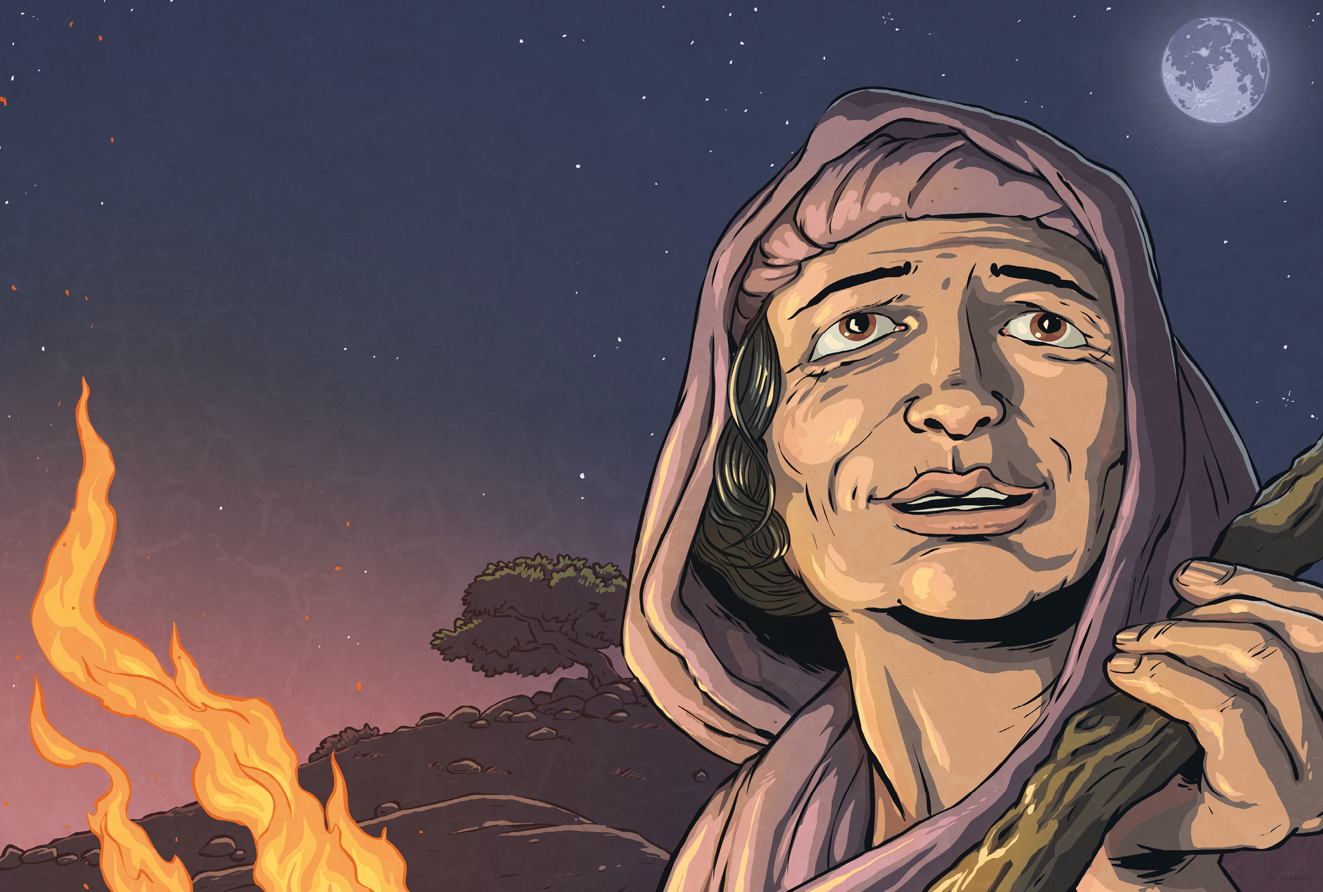
Some say that Jesus appeared to the women right there, in the garden. Some say that he met his disciples on the road to Emmaus, or on a mountain, or at a feast in Galilee. They all say that what he prophesied was fulfilled: that after he was crucified, he rose from the dead. But all that was many years ago now.
What’s that? Who do I think Jesus really was?
I think it’s a matter of faith.

Slide 2


