Slide 1
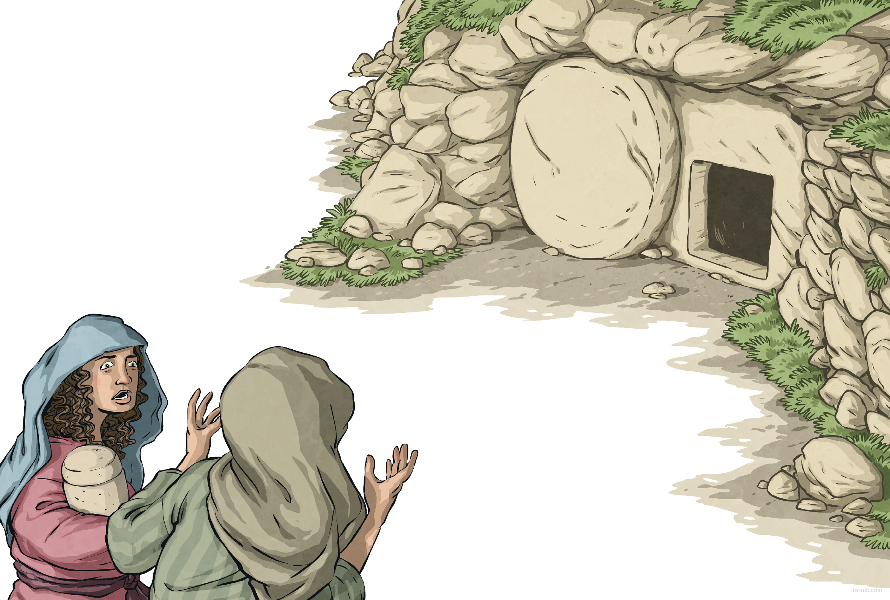
The next day was the Sabbath: a day of rest in the midst of festivities. The following day – the third day after Jesus’ death – something very strange happened.
That morning, as the sun rose, Mary Magdalene and the other women returned to the tomb with spices to anoint Jesus’ body. The crunching of their feet broke the stillness of the morning and the air was threaded with the scent of blossom.
As they entered the garden, a sight
greeted the women that made them
stop in their tracks...
The stone covering the tomb’s entrance
had been rolled away.

Slide 2
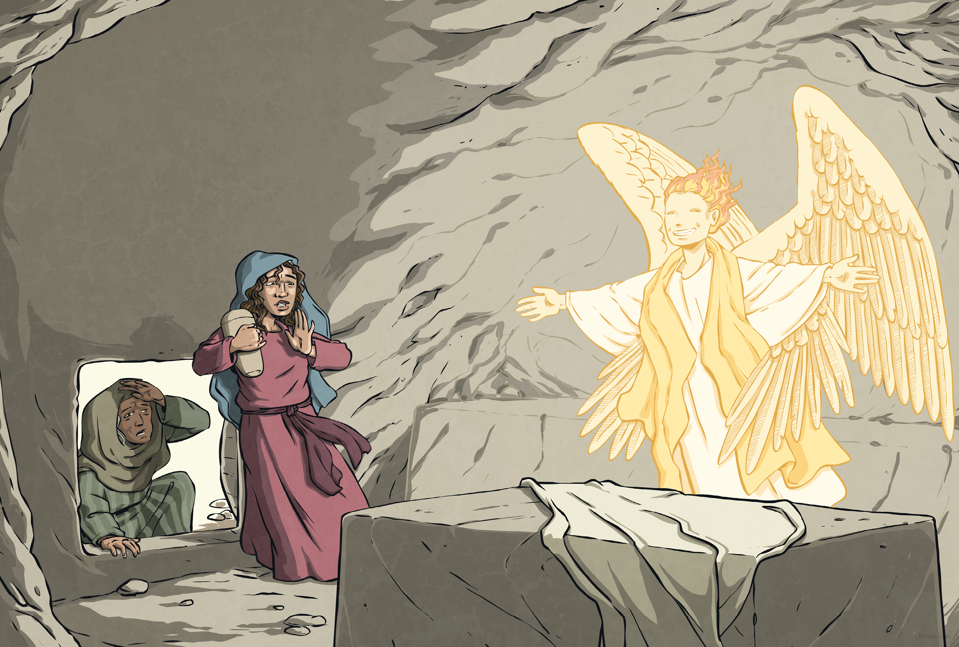
Nervously, the women stepped closer.
Inside the tomb, they saw an angel with a face like lightning and robes as white as snow.
“Don’t be afraid,” said the angel. “Jesus is not here – he has risen, as he said he would.”
The women rushed from the tomb, full of joy, to tell the disciples what they had seen and from there, the news spread all over Jerusalem.

