Slide 1
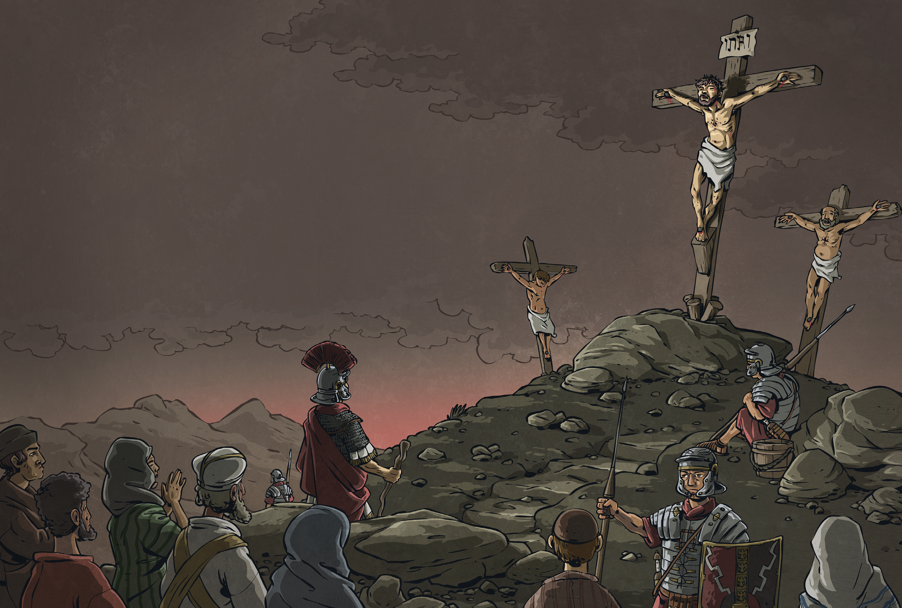
We waited.
At noon, the sky turned black. And still, we waited.
At three, Jesus cried out with a sound that seemed to shatter the sky.
The earth shook.
Quaking, the centurion who guarded Jesus cried out,
“Surely, he was the Son of God!”

Slide 2
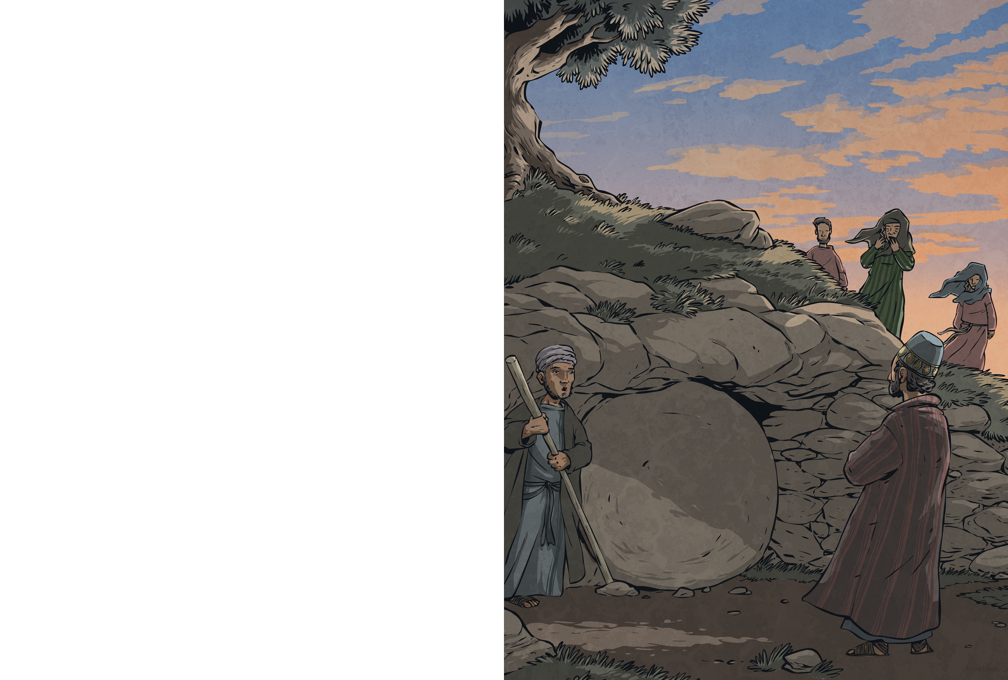
A rich man named Joseph of Arimathea asked the governor for Jesus’ body. With Pilate’s permission, he wrapped Jesus in linen cloth and carried him away.
Joseph had a tomb close by, hewn from rock. He placed Jesus inside. Nearby stood the women who followed Jesus; among them was Mary Magdalene, who had travelled with Jesus through Galilee ever since Jesus had healed her. The women watched sombrely as Joseph’s servant rolled a huge stone across the entrance of the tomb.
Jesus had been betrayed and denied, and now he lay in a tomb – but that wasn’t the end of the story...

