Slide 1
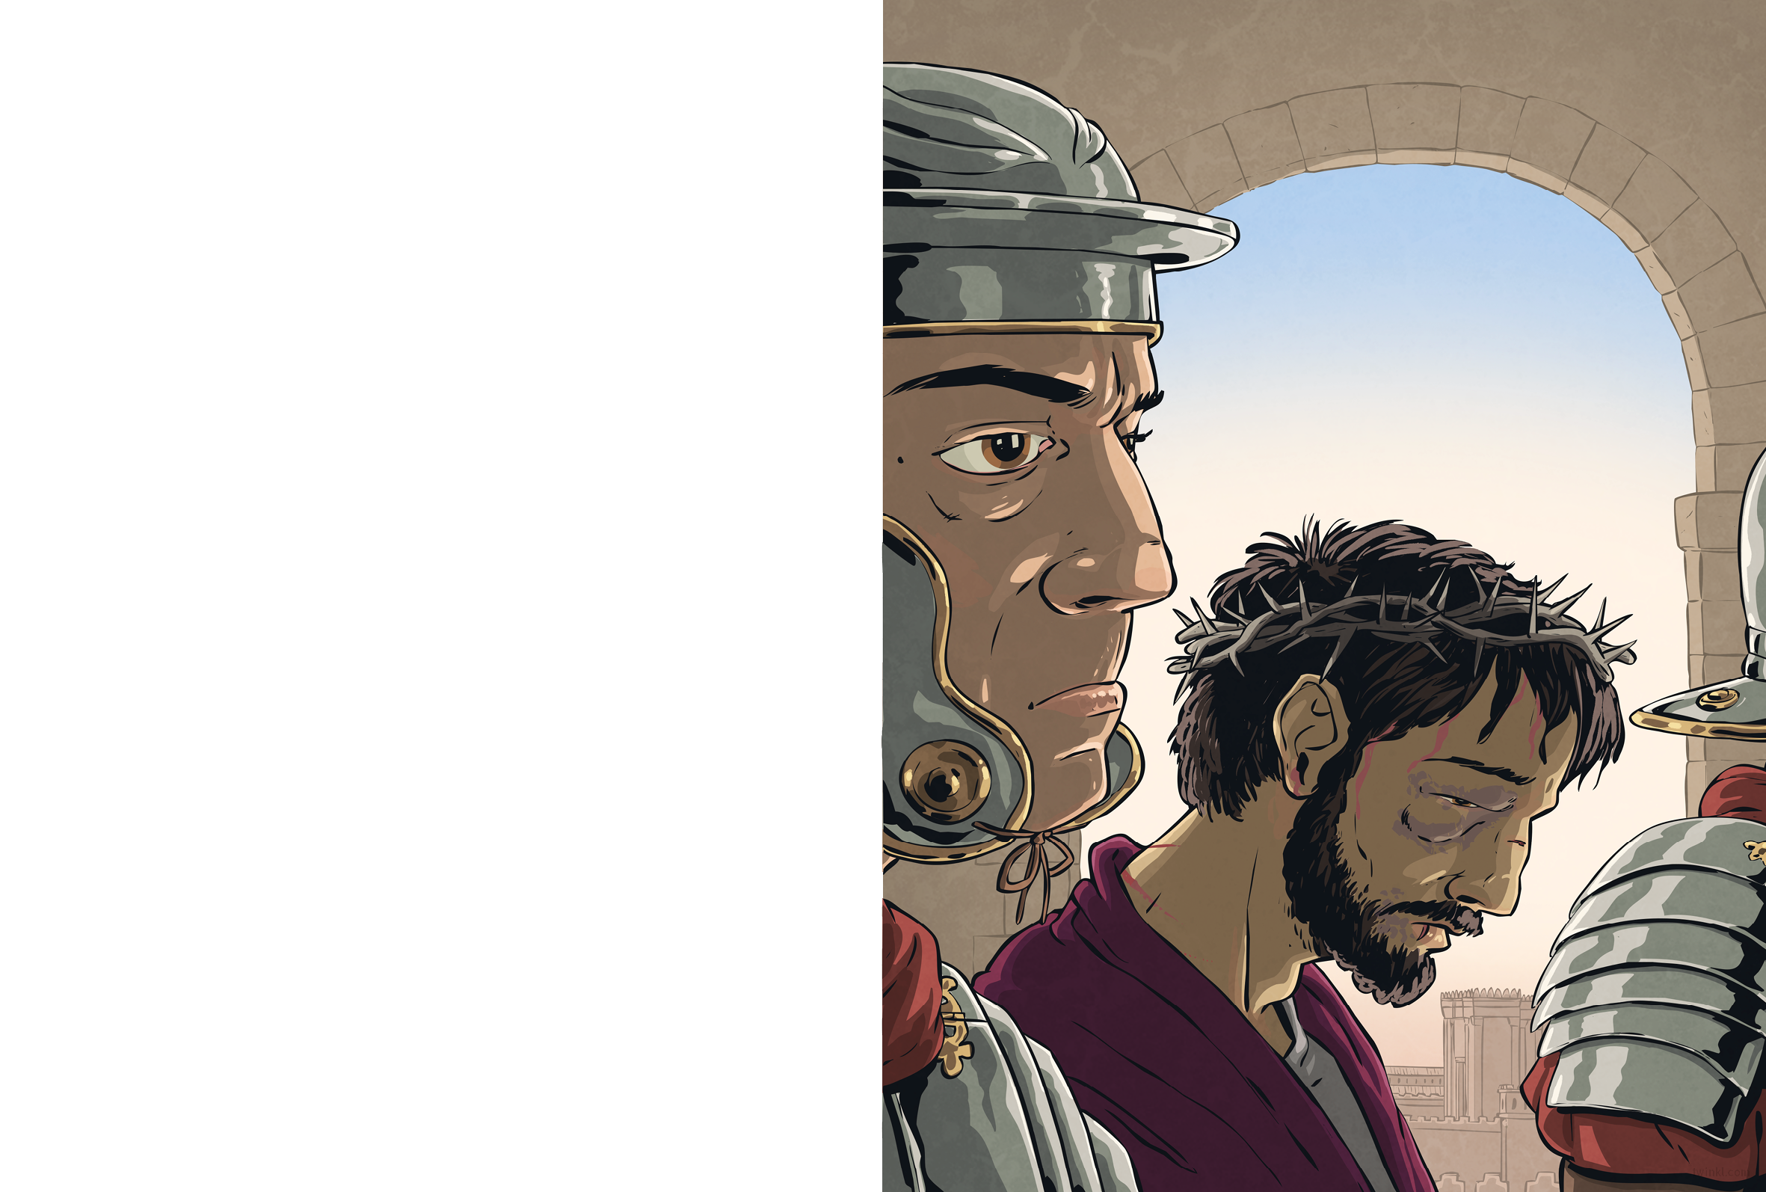
On Pilate’s orders, Jesus was marched away and dragged into the palace. We heard Jesus’ cries as they beat him.
Soon, the soldiers began to laugh. “Hail, King of the Jews!” they mocked. “Hail! Hail!”
When they pushed Jesus outside, we saw what the soldiers had done. He was dressed in a richly-coloured robe, like a king. On his head rested a crown of thorns.
The soldiers spat at him, struck him and stripped him of his kingly robe, but the crown remained, its cruel thorns digging into Jesus’ flesh.

Slide 2
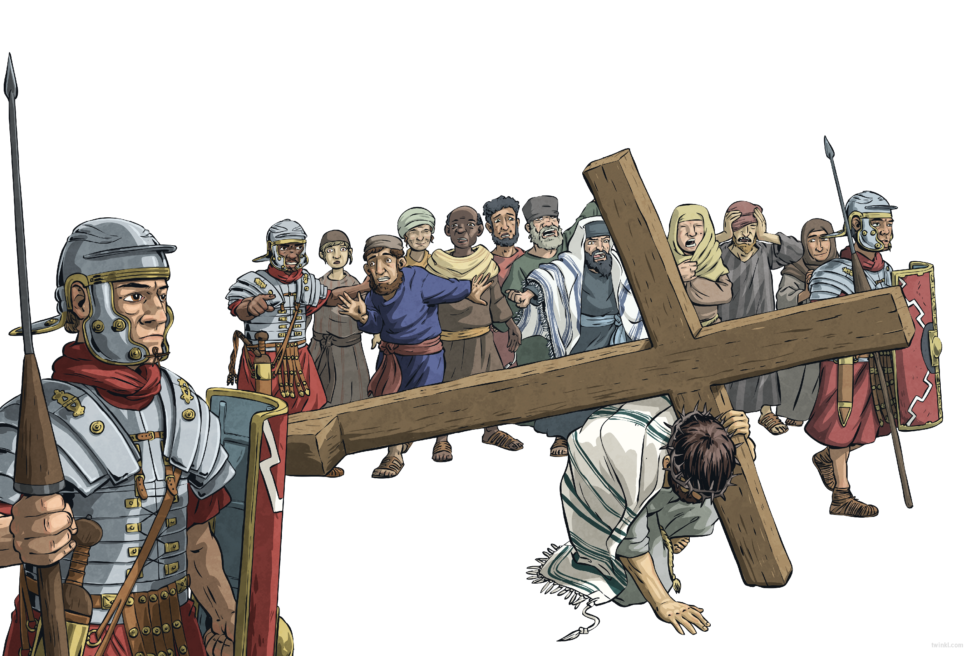
So, Jesus was led to Golgotha – ‘the Place of the Skull’. Some say that he carried his own cross, and others say that the soldiers made a man called Simon of Cyrene carry it most of the way.
Jesus was one of three to be crucified that day. Everyone watched as the soldiers offered him bitter wine and as he refused it. Everyone held their breath as the soldiers divided up Jesus’ clothes.
Then, the soldiers nailed Jesus to the cross by his hands and feet, and hoisted him aloft. Above him hung a sign:
This is Jesus, King of the Jews.

