Slide 1
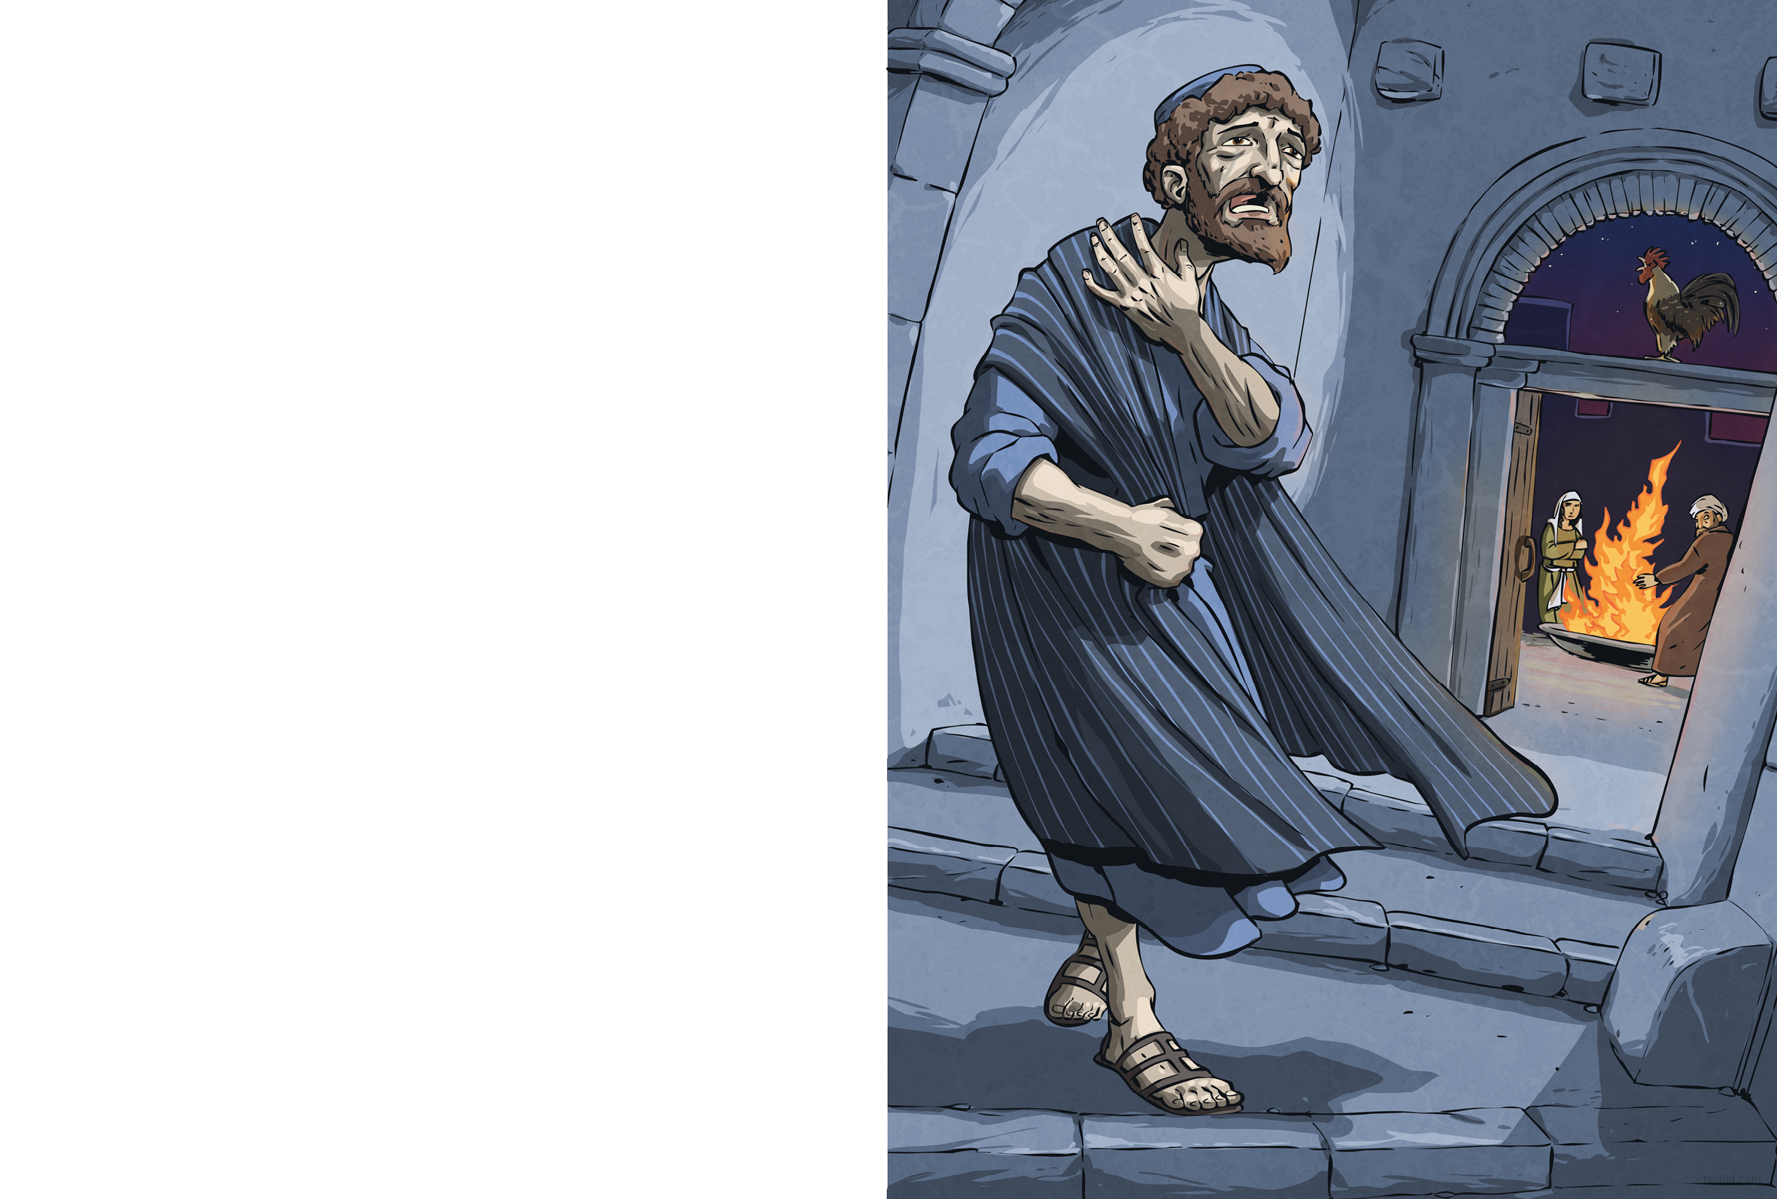
The soldiers led Jesus to the palace of Caiaphas. Peter followed at a distance, desperate for news. He trembled from head to foot.
As Peter waited in the courtyard to hear what the elders would accuse Jesus of, a servant girl noticed him.
“You’re one of Jesus’ men, aren’t you?” she asked.
Peter jumped. “I don’t know what you’re talking about!” he said at once.
“Yes, you are,” said another girl. “I can tell by your accent.”
“I don’t know the man!”
“You do, you do – I saw you together,” said a third.
“No, no!” cried Peter.
At that moment, the rooster crowed to signal morning, and Peter remembered what Jesus had foretold. As he ran from the courtyard, shame burned in his chest.

Slide 2
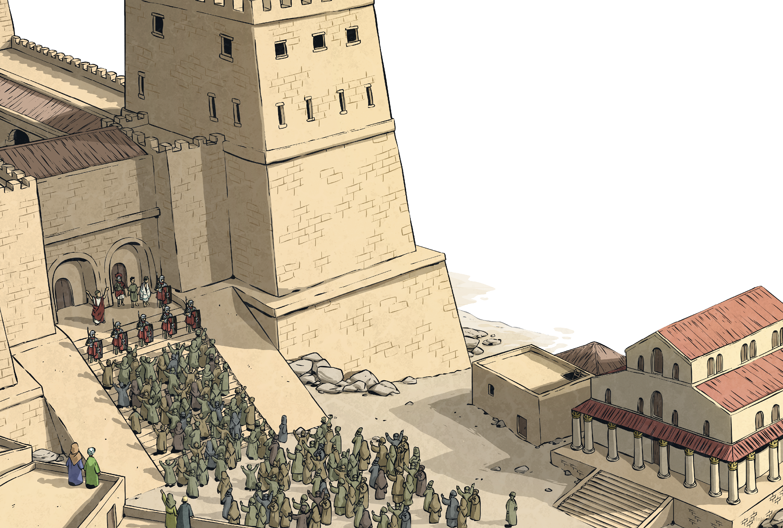
But all that, I only learnt later. The first I heard of it was in the morning, outside the governor’s palace. The Roman governor’s name was Pontius Pilate and that morning, he brought Jesus and another prisoner before the crowd. The priests had accused him of blasphemy; the governor did not like the people calling him ‘King’. Neither the priests nor Pilate had found enough evidence of Jesus’ wrongdoings to sentence him to death, so Pilate had decided to let the people decide his fate.
“Since it is Passover, you may choose one prisoner to go free,” Pilate announced. “The first is Barabbas: a rebel and a murderer. The other is Jesus, whom you call ‘King of the Jews’.”

Slide 3
At that, the crowd near the steps began to chant: “Crucify him! Crucify him!”
Jesus’ face didn’t change. He wasn’t shocked or angry; it was as if he had expected this.
Pilate asked the crowd, “What crime is he guilty of?” Undeterred, the crowd chanted louder and louder.
At last, Pilate shrugged. “Fine. Barabbas will be freed and Jesus
will be crucified. I wash my hands of this.”

