Slide 1
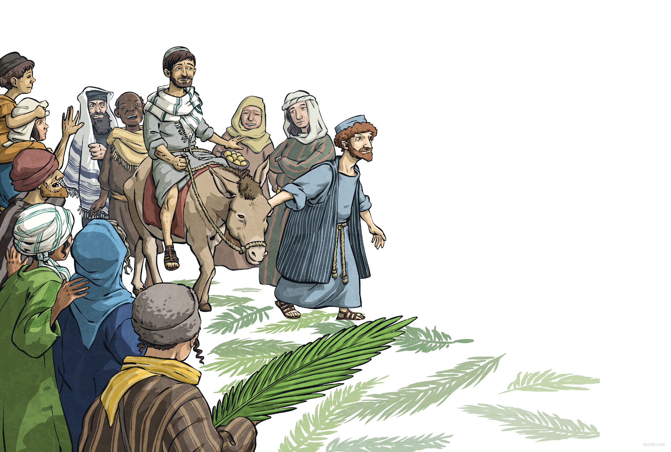
Then, we saw him: a man riding on a donkey. He didn’t look rich, powerful or special in any way, but all around, the crowd began to shout, “Blessed is the king! Peace in heaven!”
“Who is he?” said a voice, and answers flew from every side.
“He’s a teacher!”
“No, he’s a madman!”.
“Wherever he goes, he curess
the sick, the deaf and the blind.”
“Wherever he goes, he angers people.”
“He’s the Messiah – the Son of God.”
“Look, he’s going into the temple.
Let’s hear what he has to say.”
Some doubted him, some were devoted to him, but everyone swept eagerly into the temple. Little did anyone know that at that very moment, a few streets away, a plot was brewing – a plot against Jesus.

Slide 2
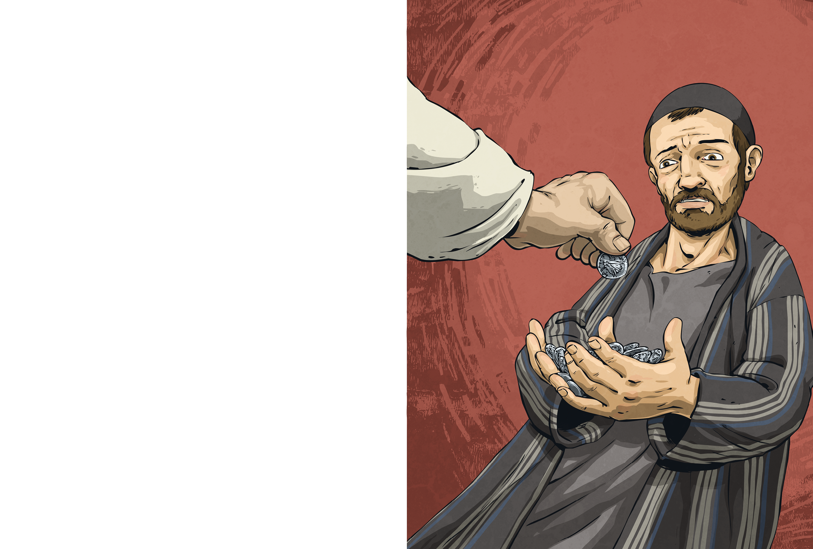
While the crowd heard Jesus preach, the High Priest Caiaphas met with all the elders of the Jewish temple. They had gathered at his palace to discuss how they could arrest Jesus – arrest him and kill him.
“That young upstart! Who does he think he is?”
“He says that he’s the Son of God!”
“He must be dealt with before he turns the people against us.”
Caiaphas called for order. “The people are listening to this man, and soon, they will stop listening to us. I have been High Priest too long to let this commoner steal my power. If we condemn Jesus publicly, the crowd will turn on him. But first, we must find him when he is alone.”
That’s when a man arrived at their gathering. His name was Judas Iscariot, and he was one of Jesus’ disciples.
“What will you give me if I agree to betray Jesus?” asked Judas
Caiaphas counted out thirty silver pieces into Judas’ palm.

