Slide 2
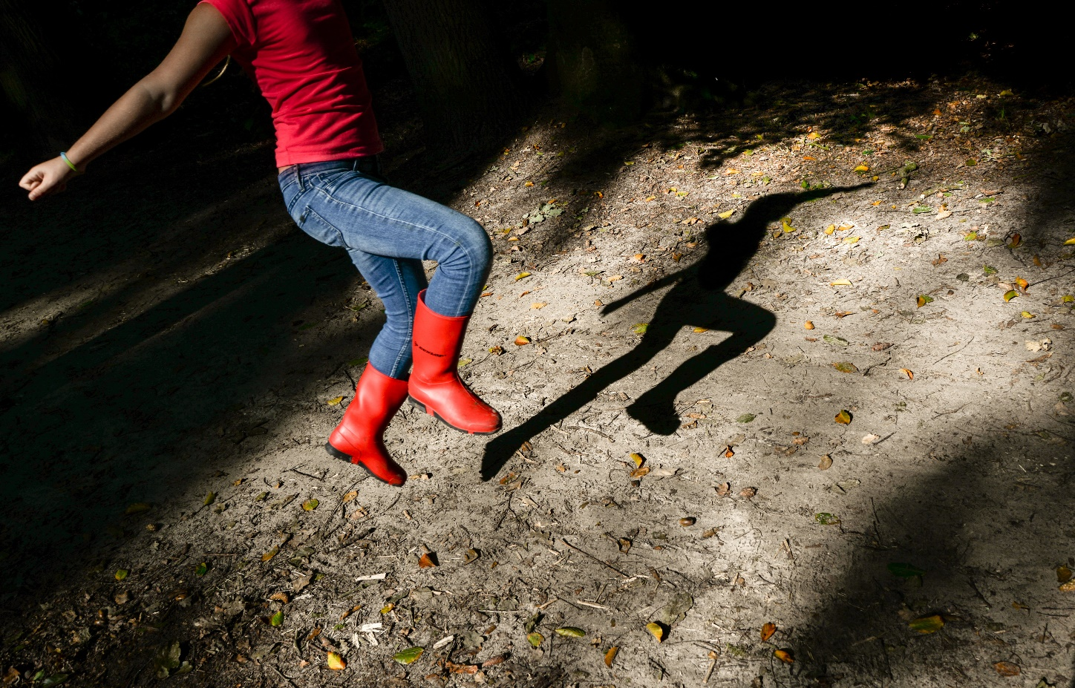
What Is a Shadow?
A shadow is formed when an object does not allow the light to pass through it.

Slide 3

What Direction Does Light Travel?
Light travels in straight lines.

Slide 4


How Are Shadows Made?
Shadows are made when there is an object blocking the light from hitting the surface.
The object needs to be a solid object. If it is clear then the sun will pass through it, whereas a solid object will block it.
This means that the shadow will always
be on the opposite side of an object to the
sun or light.

Slide 5


Which Direction Is the Sun?
Notes:
Click once to reveal the sun options, click again for answer to be revealed

Slide 6

Which Direction Is the Sun?

Slide 7
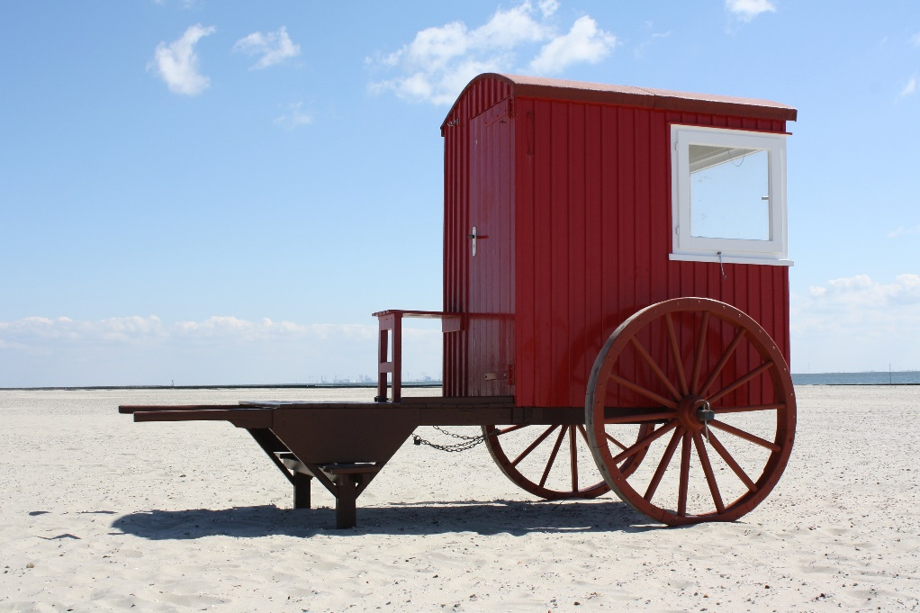
Which Direction Is the Sun?

Slide 8

Which Direction Is the Sun?

Slide 9
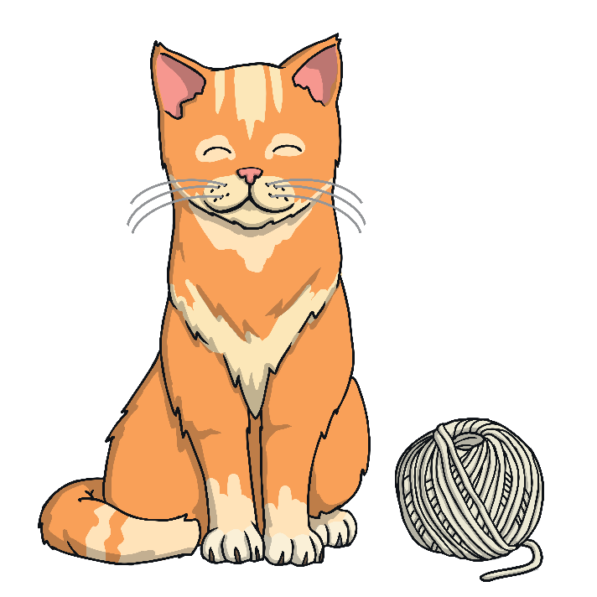

Your Task
Using only aluminum foil, you are going to create an object that stands unsupported and will create an interesting shadow.
Think: How will the sun change how the shadow appears on the ground?
Think: How can you spread the weight so that it stands on its own?

Slide 10

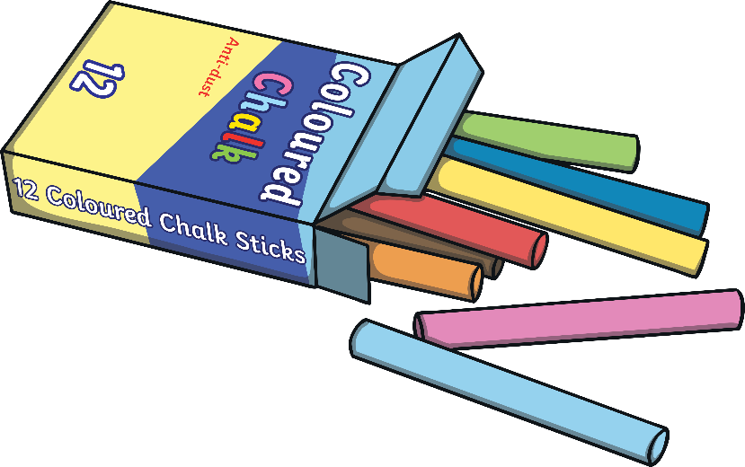
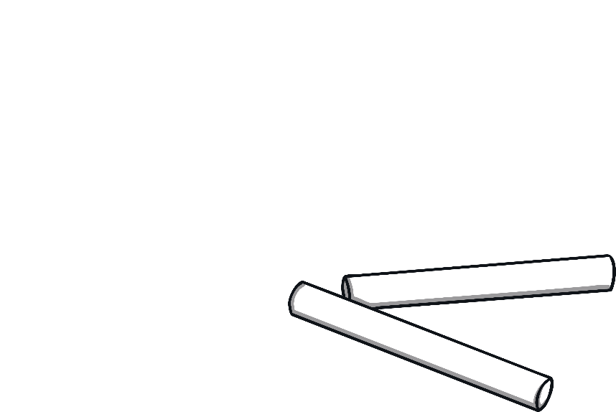
You Will Need
Aluminium foil
Chalk (1 per student)
Coloured chalk (1 per class)

Slide 11


Step 1
Create your object and make sure that it can stand up unsupported.

Slide 12
Step 2
Place your creation in the sun and trace around the shadow with the chalk.
Move it around and draw it again to see how the shadow changes.

Slide 13



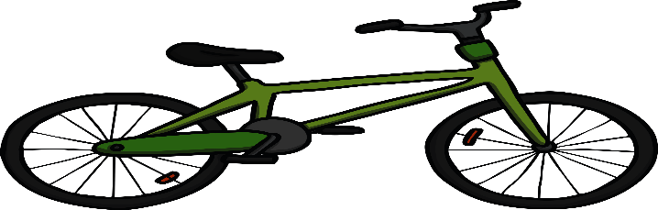
Step 3
Have fun and turn your chalk drawings into little characters. See if you can find other objects that make interesting shadows that you can use to create a picture.

Slide 14



Go Further
Write a story using your chalk creations as the main characters.

Slide 15

Reflection
How did you get your creation to stand?
Why did that work?
What changes did you make to make it an interesting shadow?
What happened when you moved it around?

