Slide 1
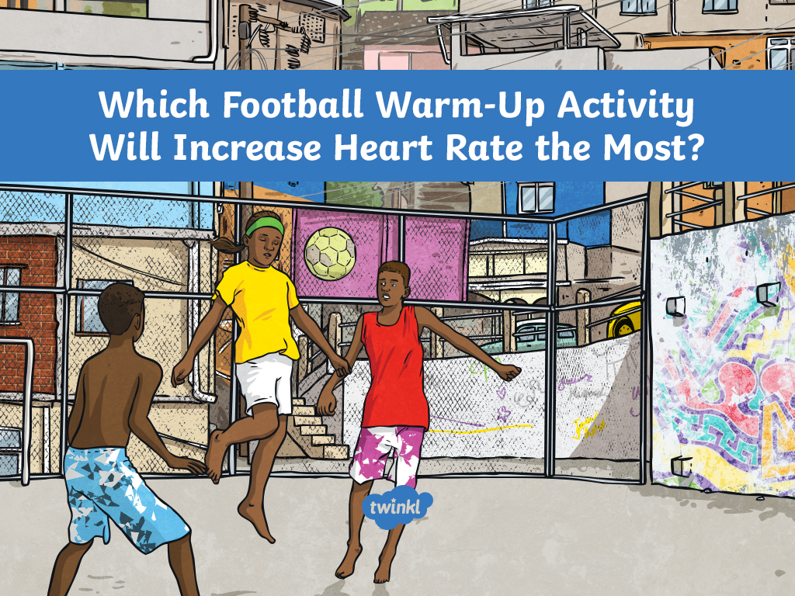

Slide 2
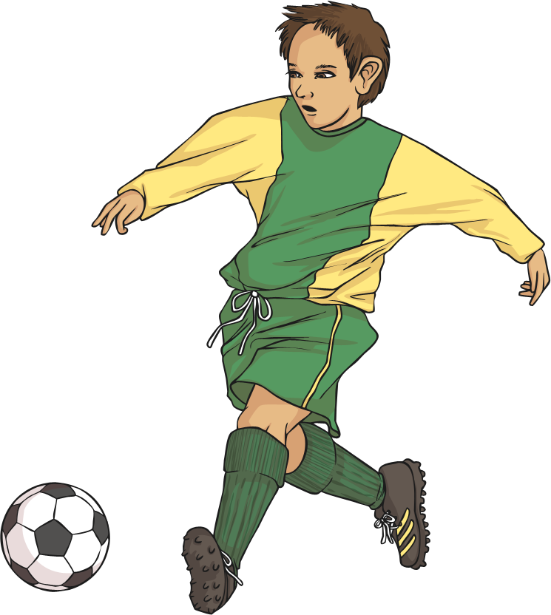
Which Football Warm-Up Activity Will Increase Heart Rate the Most?
Before football matches, it is important that footballers warm up correctly in order to avoid injury.
You are going to be investigating the affect different footballing warm-ups have on heart rates.
What warm-up exercises do you know?

Slide 3
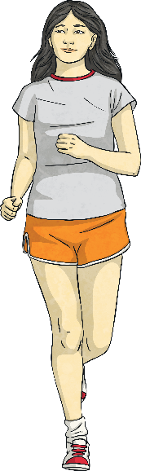
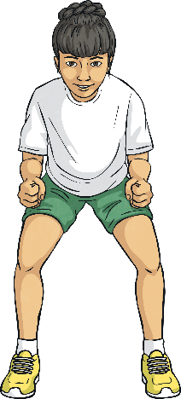
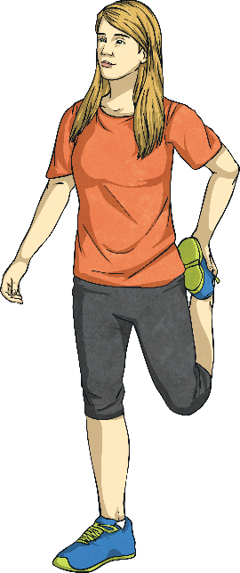
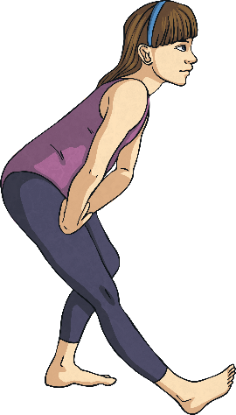
Science Investigation
There are many different pre-match warm-ups that footballers do. You are going to work with the following exercises:
Gentle jogging
Quick sidesteps (Stand side-on, move one leg out and then snap the other leg together. Jump in the middle of the move so both feet are off the ground.)
Hamstring stretch (Put one foot in front of the other. Straighten your front leg and lift up the toe of that foot. Bend your back leg.)
Quadricep stretch (You might need to hold on to something for this one! Bend one knee backwards and hold on to it with your hand. Keep your knees together.)

Slide 4

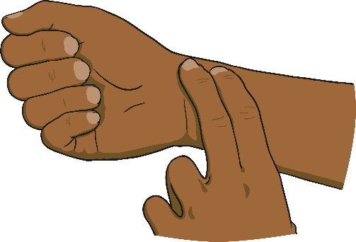
Measuring Your Heart Rate
Measuring your heart rate means counting how many times it beats in one minute.
You can do this by placing two fingers on your wrist and feeling for a pulse. If you can’t find it, put two fingers on the side of your neck.
Your partner should set a stopwatch for one minute. When they say go, count how many times you feel the pulse.

Slide 5
Method
1
Measure your resting heart rate and write it in the table.
2
Perform the first exercise.
3
Measure your heart rate and write it in the table.
4
Allow your heart to return to its resting rate.
5
Repeat steps 2, 3 and 4 for the other exercises.

Slide 6

Variables
What are you going to be keeping the same in the experiment?
The length of time you do each exercise for.
The length of time you measure your heart beat for.
Your heart rate before starting an exercise (resting pulse rate).
What are you going to be changing in the experiment?
The type of exercise.

Slide 7
Results
Exercise | Heart Rate
Resting
Which exercise increased heart rate the most?

Slide 8
Conclusion
Which exercise increased the heart rate the most?
Was there a big difference?
Was there a type of activity that increased it more?

