Slide 1


Meet the Teacher!
Miss Dawes
Miss Greenwood, Mrs De, Miss Thompson, Mrs Gabbitas and Mr Munir will be supporting the class.

Slide 2
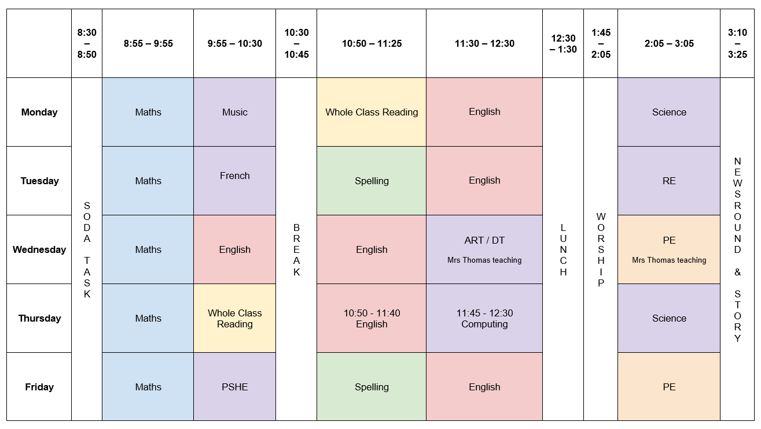
Timetable

Slide 3
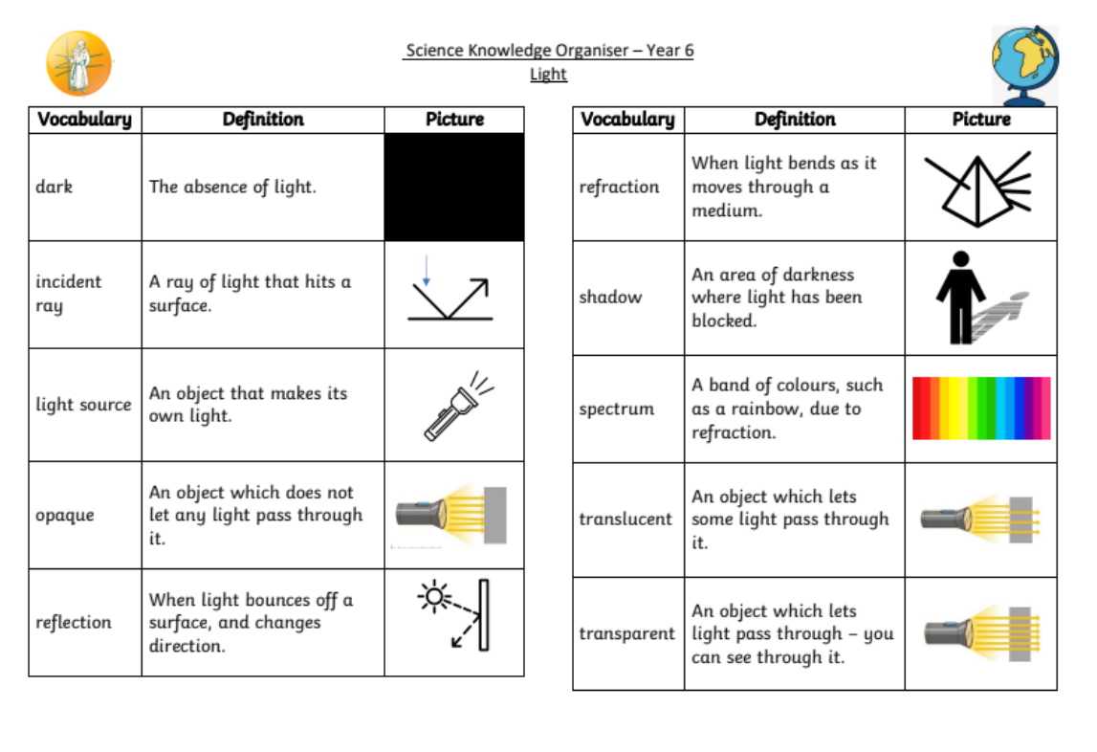
Knowledge Organiser

Slide 4
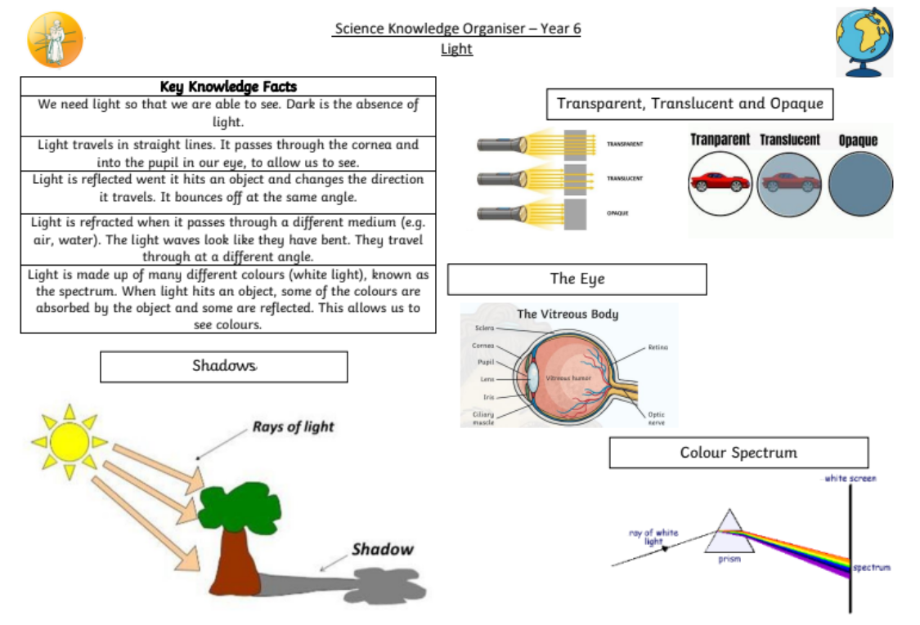
Knowledge Organiser

Slide 5
Trips
Autumn | Spring | Summer
Gurdwara | Calshot | Whiteleaf Waddesdon

Slide 6
Reading
Your child will learn reading skills during Whole Class Reading (WCR) sessions in class.
To encourage the children to read for pleasure, we will read a class novel each day.
These are skills which will then be practiced at home. We want children to enjoy reading and sharing books with you!

Slide 7
Writing
To ensure maximum progress for all pupils, we have adopted a whole school approach to writing. The children will be introduced with an exciting ‘hook’ to inspire and ignite learning.
The children will then engage with the writing process: analysing texts, planning, drafting, editing and publishing their work.

Slide 8
Maths
The key focus for Maths is fluency, reasoning and problem solving in all lessons. This is an area we will continue to develop this year.
We encourage you to help your children through learning their number bonds and multiplication facts and using these in real life situations to improve their reasoning.

Slide 9
SATS and KS2 Framework
SATs week is the 12th May 2025.
Reading, GPS and Maths papers (1 arithmetic paper and 2 reasoning papers).
Children are awarded expected standard or not in Reading, Maths and Science.
In writing, children are awarded working towards, expected standard or greater depth. If you wish to see examples of the expected standard and greater depth to the Framework document, follow this link - https://www.gov.uk/government/publications/2018-teacher-assessment-exemplification-ks2-english-writing .

Slide 10
PE
Wednesday – Indoor PE
Friday – Games outdoors
Children should wear PE kits to school, instead of school uniform, on PE/ Games days.
Earrings need to be removed for all PE sessions.

Slide 11
Homework
Spellings will be given out every Friday– children will be tested on a Tuesday.
Learning logs will be set once a half term and children will have two weeks to complete their learning logs.
Reading – please encourage your children to read daily. You will shortly receive information about our new record of recording this.
Times tables – A quick recall of times table facts up to 12 x 12 is very important. If your child doesn’t know them, these need to be practiced daily.
Atom Learning - A piece of Maths and English will be set weekly to be completed online.

Slide 12
Rewards and Sanctions
Everybody at Monks Risborough believes in praising positive behaviour and hard work!
Values Passport
Thriving Champion
House points
Postcards home
Stickers
Verbal praise

Slide 13
Rewards and Sanctions
Behaviour Thermometer
Children start each day not on the behaviour thermometer.
If a child repeatedly disrupts the class then they will be put onto the behaviour thermometer and will miss part of break to think about their behaviour.
If the teacher has to then speak to the child again, they will move up the thermometer and the consequences will increase.
Children may go straight onto a higher level of the behaviour thermometer depending on their behaviour.

Slide 14
Responsibilities
All children in the class will be given a responsibility.
There will be a range of roles on offer and children will have the chance to volunteer for them.

Slide 15
Secondary School
Preparing children for secondary school this year
10th and 12th September – 11+ Test
11th October– 11+ Results
31st October – deadline for secondary school applications

Slide 16
Website
http://www.monksrisboroughprimary.com/
Year 6 Class Page
https://www.mrisborough.bucks.sch.uk/6-eagles-5/

Slide 17
General Reminders
Uniform (names in clothes)
Water bottles
Fruit or Vegetable snack at playtimes in a sealed bag or container
Please limit the items children are bringing to school with them each day. All stationary is being supplied by the school.

Slide 18
Questions
Please send any general questions into the school office. I will make a FAQ answer sheet from the general questions I receive.
Otherwise please request a phone call with me via office@monks.org.uk to discuss your child personally.

