Slide 1
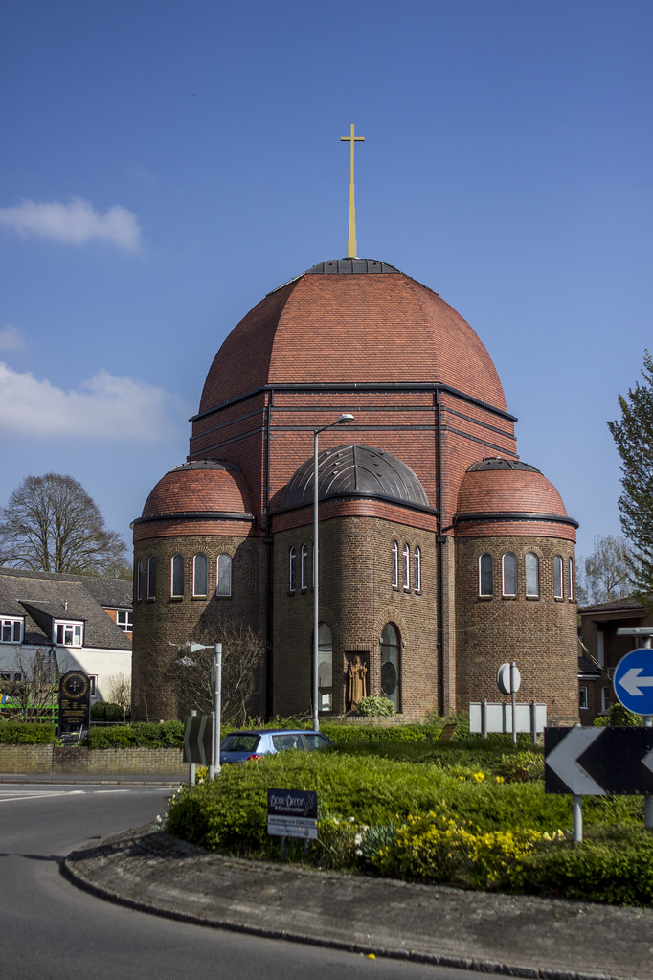
St Teresa’s Church
Princes Risborough

Slide 2
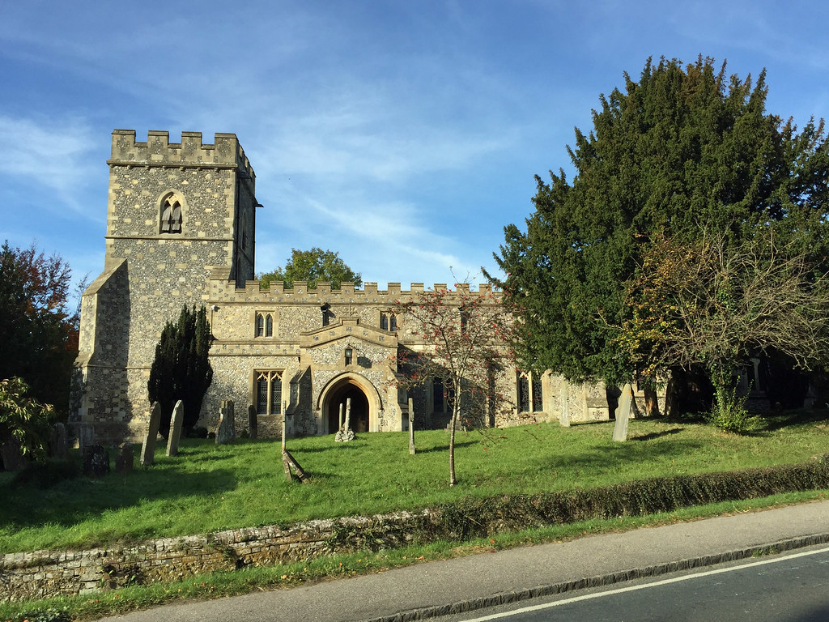
St Nicholas’ Church Kimble

Slide 3
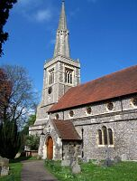
St Mary’s Church Princes Risborough

Slide 4
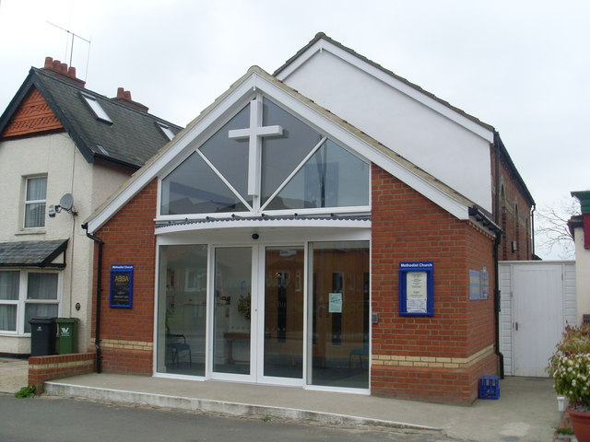
The Methodist Church Princes Risborough

Slide 5
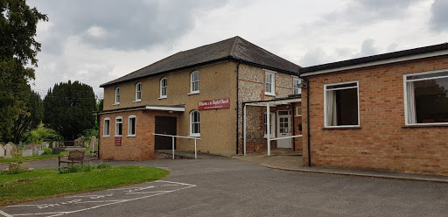
Princes Risborough Baptist Church

Slide 6
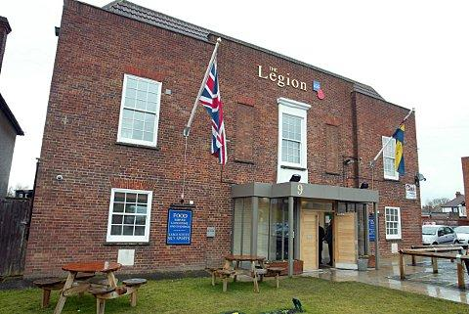
Elim Church Princes Risborough

Slide 7
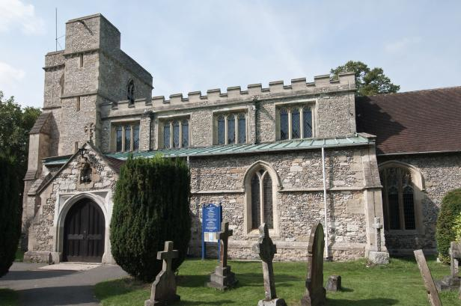
St Dunstan’s Church Monks Risborough

