Slide 1


Meet the Teacher!
Miss Goodright
Miss Greenwood will be supporting the class

Slide 2
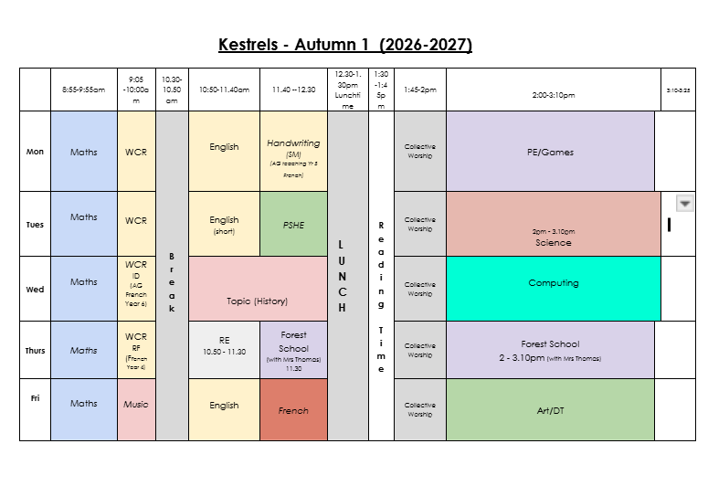
Timetable

Slide 3
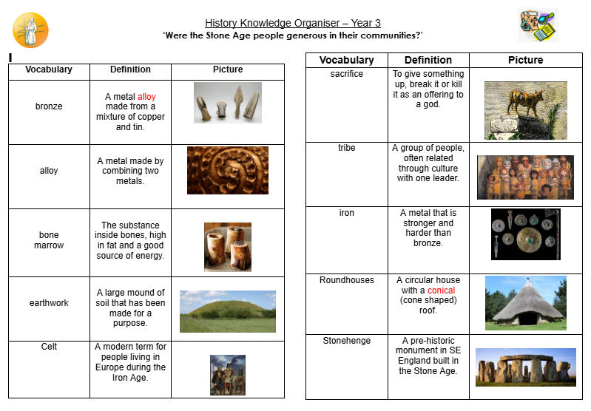
Knowledge Organisers
Needs amending but I cant find on drive

Slide 4
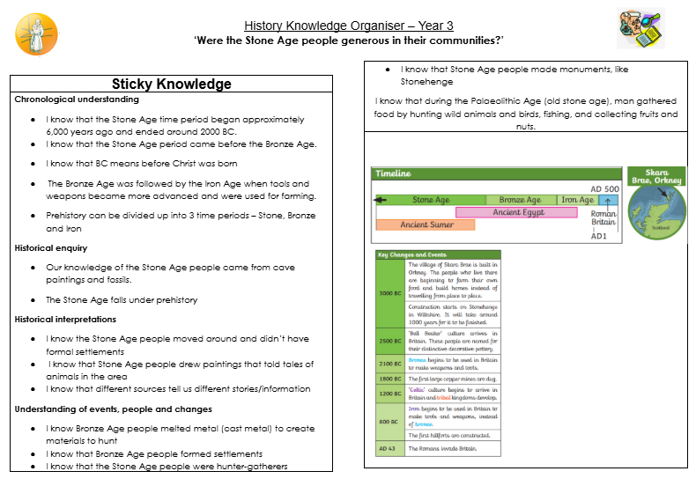
Knowledge Organisers
Needs amending but I cant find on drive

Slide 5
Trips
Autumn | Spring | Summer
Oxford Museum investigating Rocks & soils and life in the stone age | Greek Day (History off the Page) | High Wycombe Mosque
Trips are organised to enhance learning opportunities for the children. If trips cannot be taken then we will investigate alternative options.

Slide 6
Reading
Your child will learn reading skills during whole class reading sessions
We will read a class novel each day to encourage the children to read for pleasure
Reading skills should also be practised at home. Children will either remain on the RWI reading scheme, or choose a book from the reading corner/trolley. They should try to read daily and write/sign (by you or by them) their reading record. Each supported read leads to our Red Ted award challenge. We are keen for children to enjoy reading and sharing books with you!
Books in Year 3 are organised into ‘quick reads’ (top shelf), ‘class reads’ (more challenging longer reads) and ‘trolley books’ (specifically selected to improve vocabulary and suitable for year 3 children).

Slide 7
Red Ted Reading Challenge
RED TED stands for Read Every Day, Talk Every Day. We expect children to read at home with an adult at least 3-5 times a week depending on their age, to help them develop and practise their reading skills.
How can my child earn rewards?
Children can earn rewards by reading at home. This can be with an adult or independently – it just needs to be written in their reading record, which should already be in school every day. Children need to show the adults in their class their reading record (adults may ask them questions about the book to check!) and once they have completed 10 reads, they will receive their very first reward!
What are the rewards?
10 reads = A RED TED sticker (You will receive a sticker for each multiple of ten reads you collect)
100 reads = A trip to the Headteacher’s office to choose a book from her special RED TED library
200 reads = A book and a RED TED badge
300 reads = A book and a RED TED wristband
400 reads = A book and a RED TED teddy
500 reads = A visit to the Office to choose a book on the computer
600, 700, 800, 900 reads = A £5.00 book token
1000 reads = mystery prize!
For every 100 reads after 1000 reads, children will continue to be rewarded with a choice of book.
Good luck!

Slide 8
Writing
Writing is an area of improvement on our School Development Plan this year. We will be teaching our writing through a book that is linked to our topic.
To ensure maximum progress for all pupils, we have adopted a new whole school approach to the teaching of writing. This includes introducing writing with a ‘hook’ to engage all pupils, analysis of texts, drafting, editing and publishing
Writing objectives will be displayed in the front of their English books.

Slide 9
Maths
The key focus for Maths is fluency, reasoning and problem solving in all lessons. This is an area we will continue to develop this year.
We encourage you to help your children develop their maths skills, through learning their number bonds and multiplication facts and using these in real life situations to improve their reasoning.

Slide 10
PE
Monday – Games outdoors
Thursday – Forest School (Autumn Term)
Children should come into school in their PE Kit on Monday. If it is cold, children will need to ensure they have long, plain black tracksuit trousers and a school jumper.
Earrings must be removed for all PE sessions.

Slide 11
Home learning
Reading – This is so important! Please encourage your children to read daily and record this in their Reading Record.
Learning Logs – These will be set once a half term and children will have two weeks to complete them. More information will be given when the first one is sent out.
Maths – Practising fluency skills will be beneficial to you child, especially in multiplication. Please use TTRS as a tool to practise these skills. By the end of Year 4 (next year) children will need to be fluent in all x tabe facts.
ATOM Learning - on the weeks when there is no learning log task set, we will set work on the ATOM Learning site - one short English task and one short maths task.

Slide 12
Rewards and Sanctions
Everybody at Monks Risborough believes in praising positive behaviour and hard work!
‘Thriving Champion’
House points
Head Teacher’s award
Verbal praise
Table points – we weekly rewards
‘Values Passport’ When children demonstrate one of the school values they will receive a stamp. When they have collected enough stamps they can exchange this for a reward.

Slide 13
Rewards and Sanctions
Behaviour Thermometer
If a child repeatedly disrupts the class then they will be sanctioned in line with the school behaviour thermometer and will miss part of break to think about their behaviour.
If the teacher has to then speak to the child again, they will move up the thermometer and the consequences will increase.
Children may go straight onto a higher level of the behaviour thermometer depending on their behaviour.

Slide 14
Website
http://www.monksrisboroughprimary.com/

Slide 15
General Reminders
Uniform (names on clothes)
Water bottles
Fruit, vegetable or healthy snack at playtimes (snacks are not provided in Key Stage 2)
In order to limit the items children bring to school with them each day all stationery will be supplied by the school.

Slide 16
General Reminders
If you have any questions or would like to discuss anything further, please do not hesitate to contact me through the appropriate channel - either via the school home learning email address or the school office, noting FAO A Goodright
homelearning@monks.org.uk

